Slide 1
Statistics: Behavioral and EEG data
Images of Association of Behavioral and ERP Data as well as Images of statistical tests

Slide 2
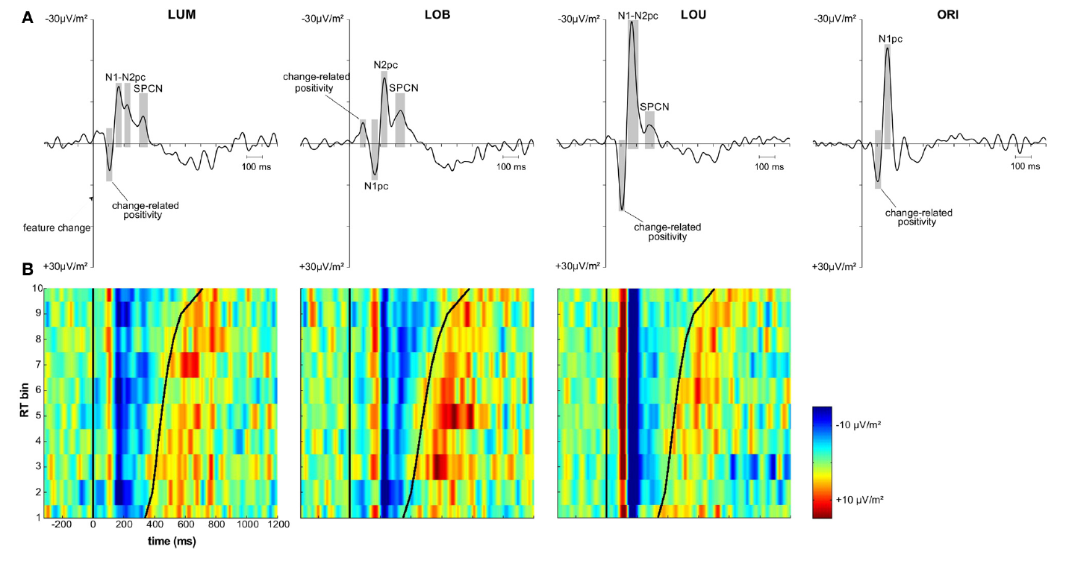
Role Model for Analysis: Paper by Sven

Slide 3
ERP images
Sorted all eeg data (all subjects, all trials) in vincentiles (10 bins) for the two error measures pursuit latency and epoch error
For each condition separately
One electrode at a time (FC3 and P3)
See ERP images of vincenticed data

Slide 4
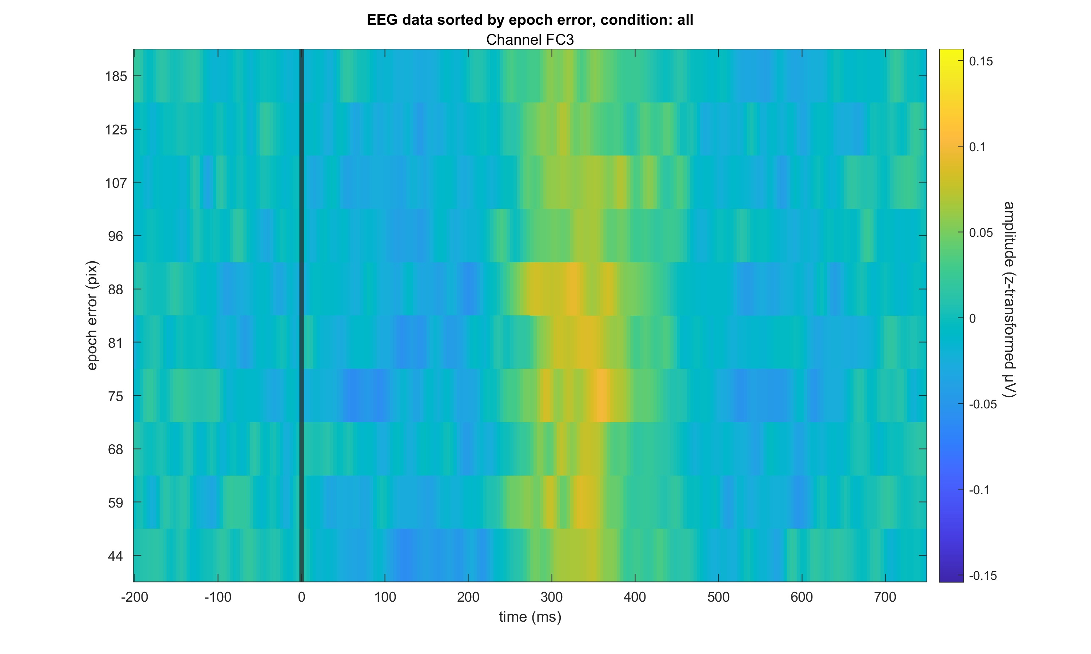

Slide 5
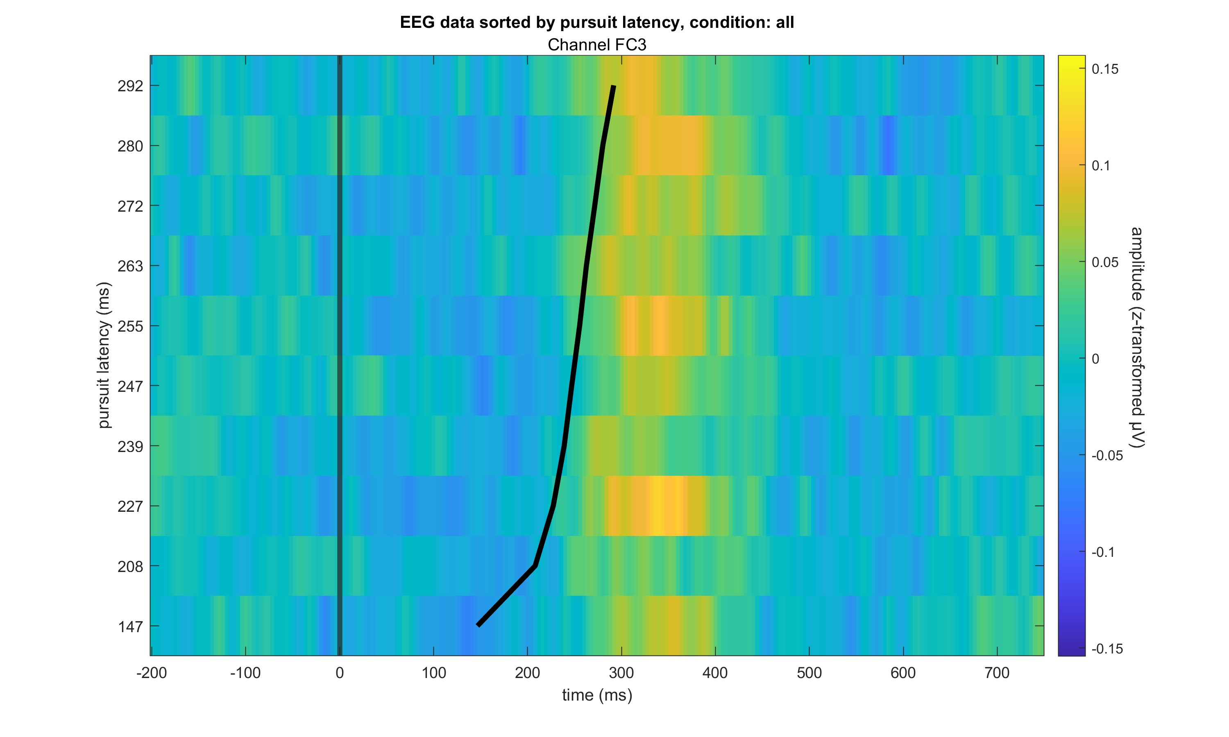

Slide 6
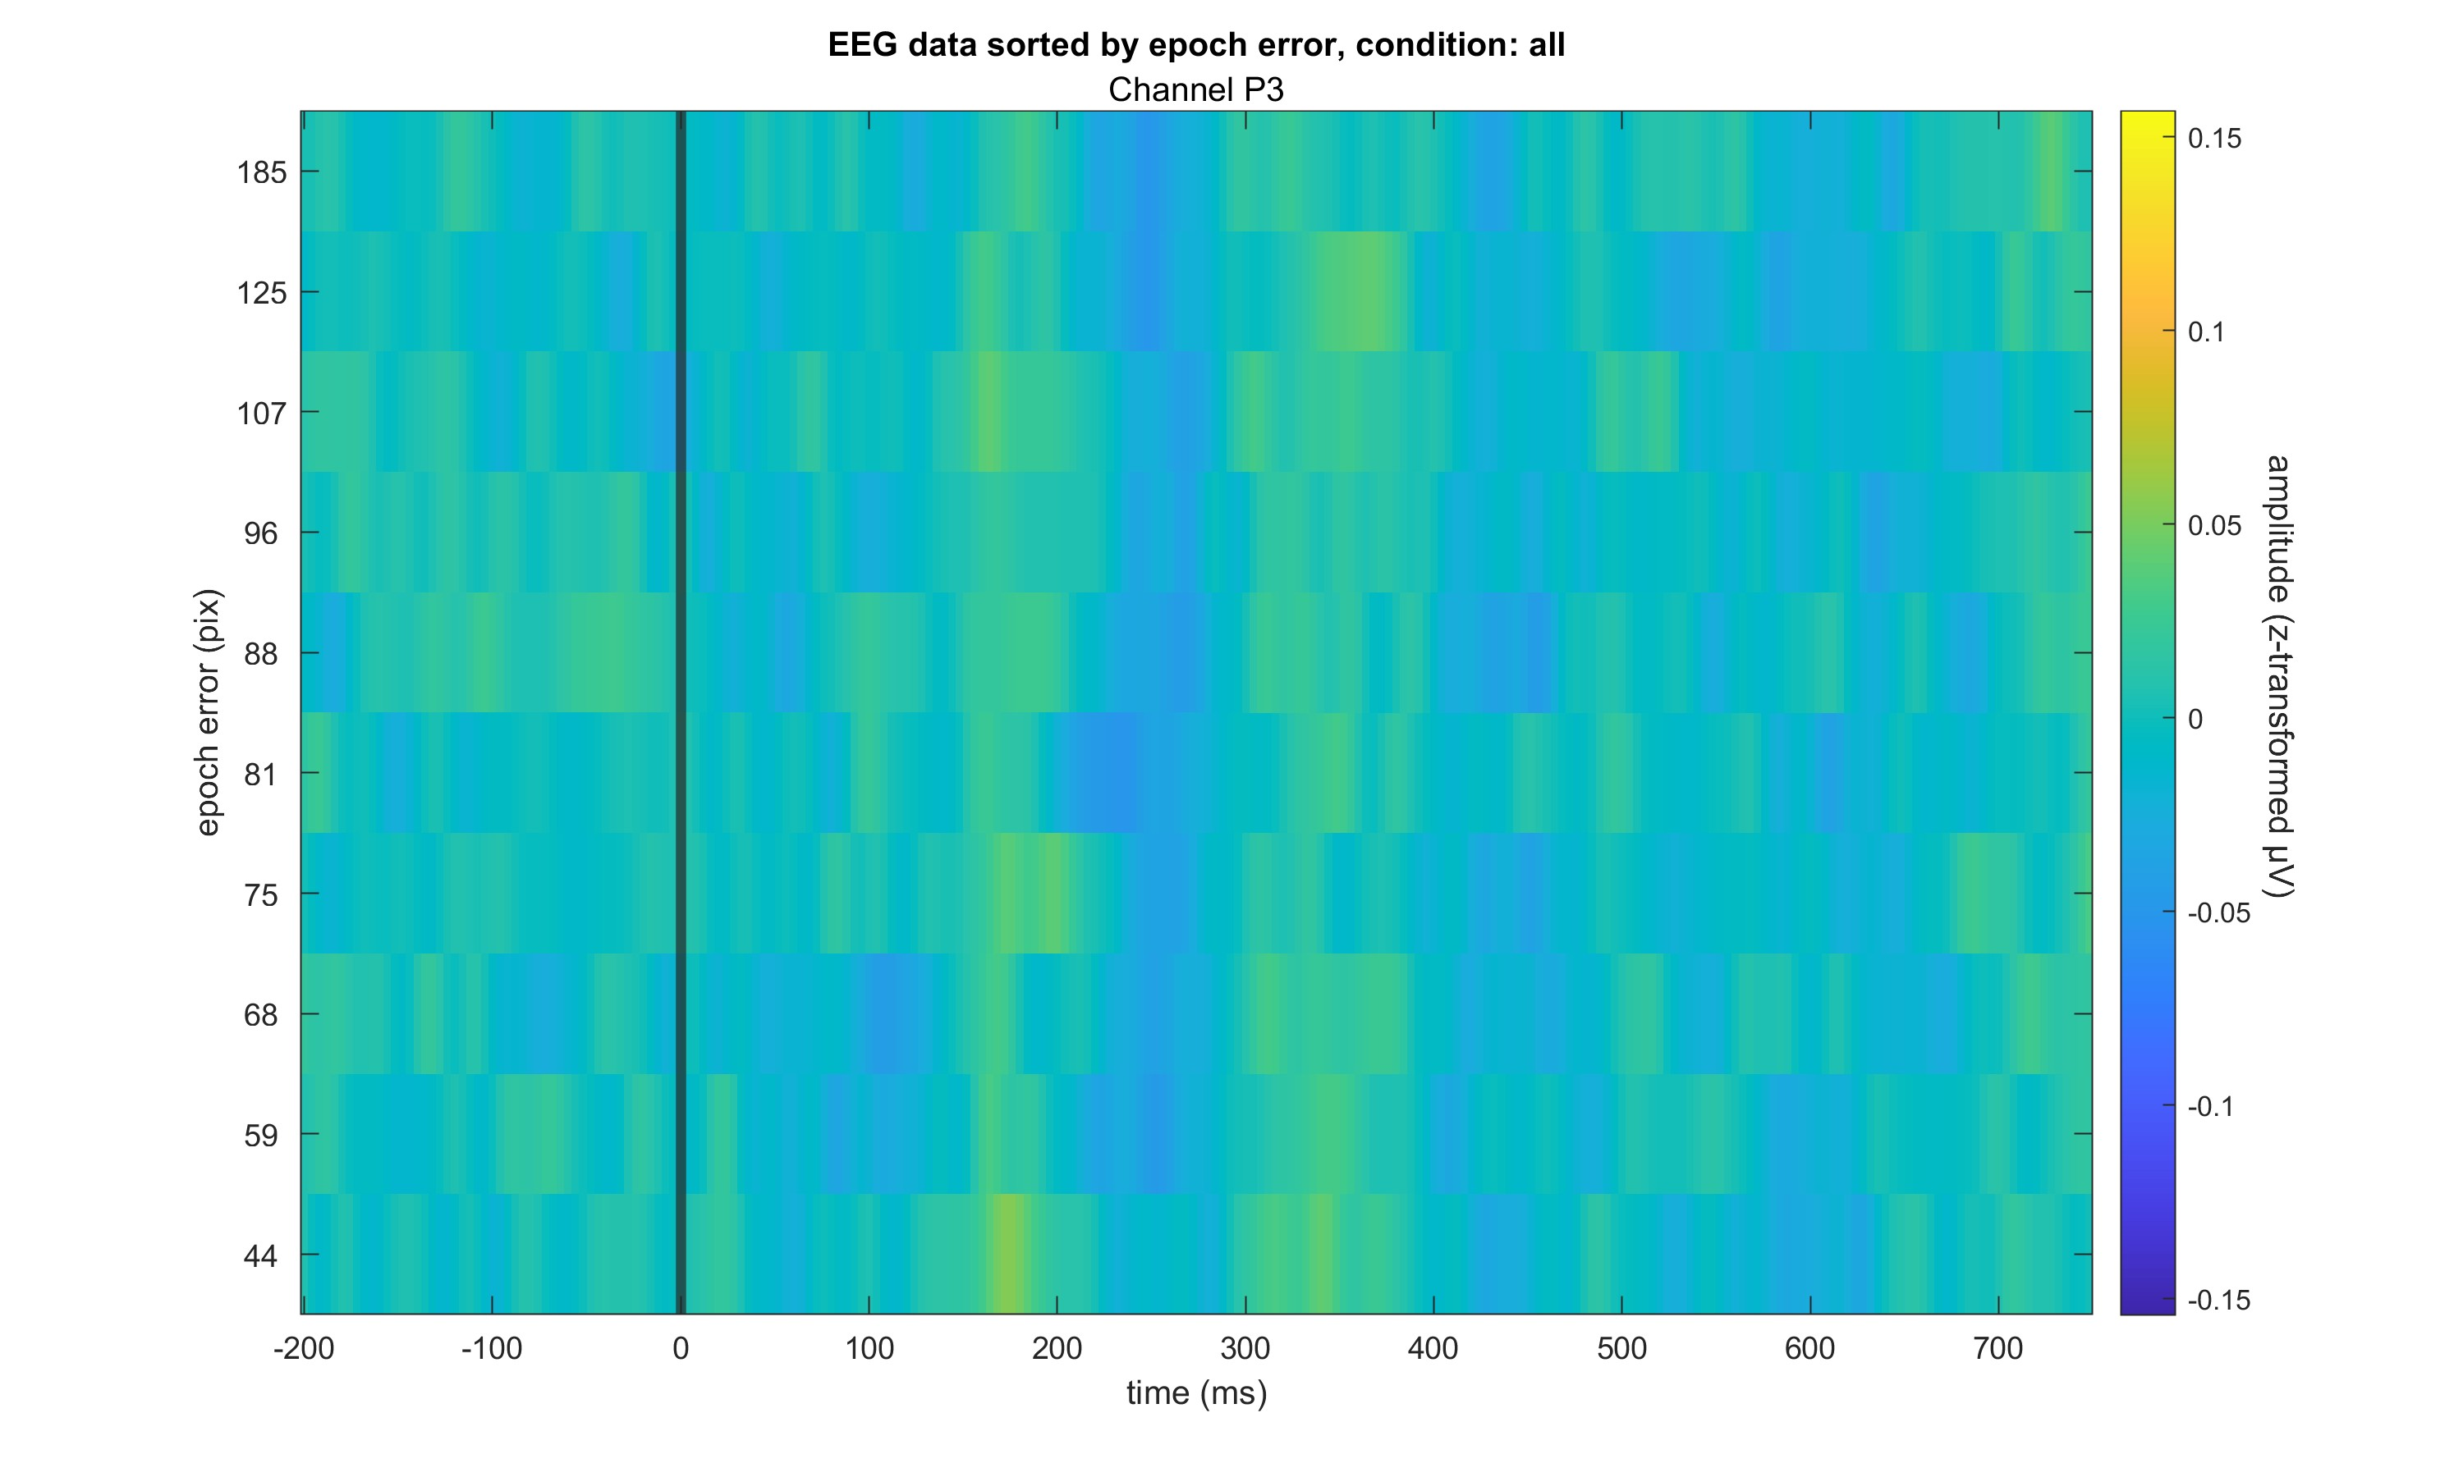

Slide 7
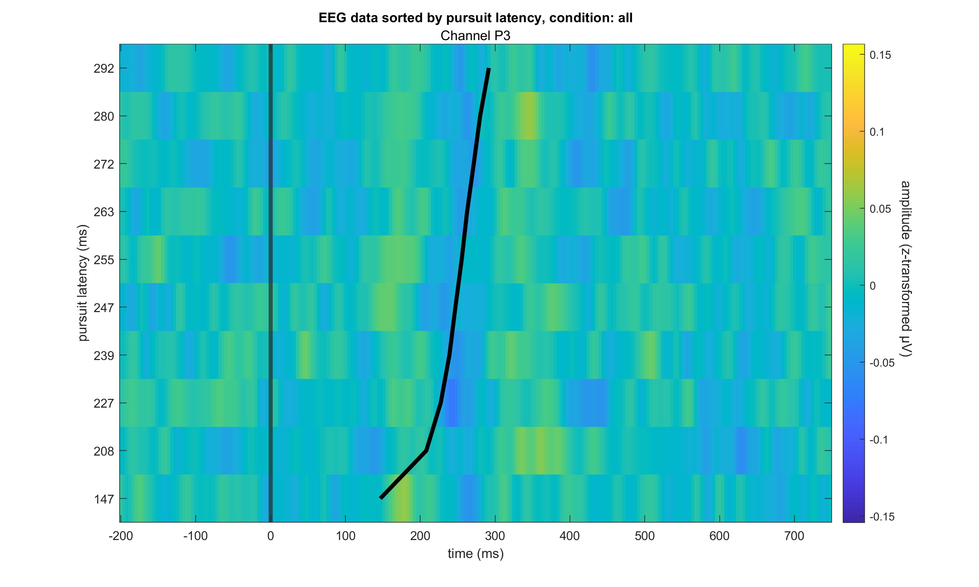

Slide 8
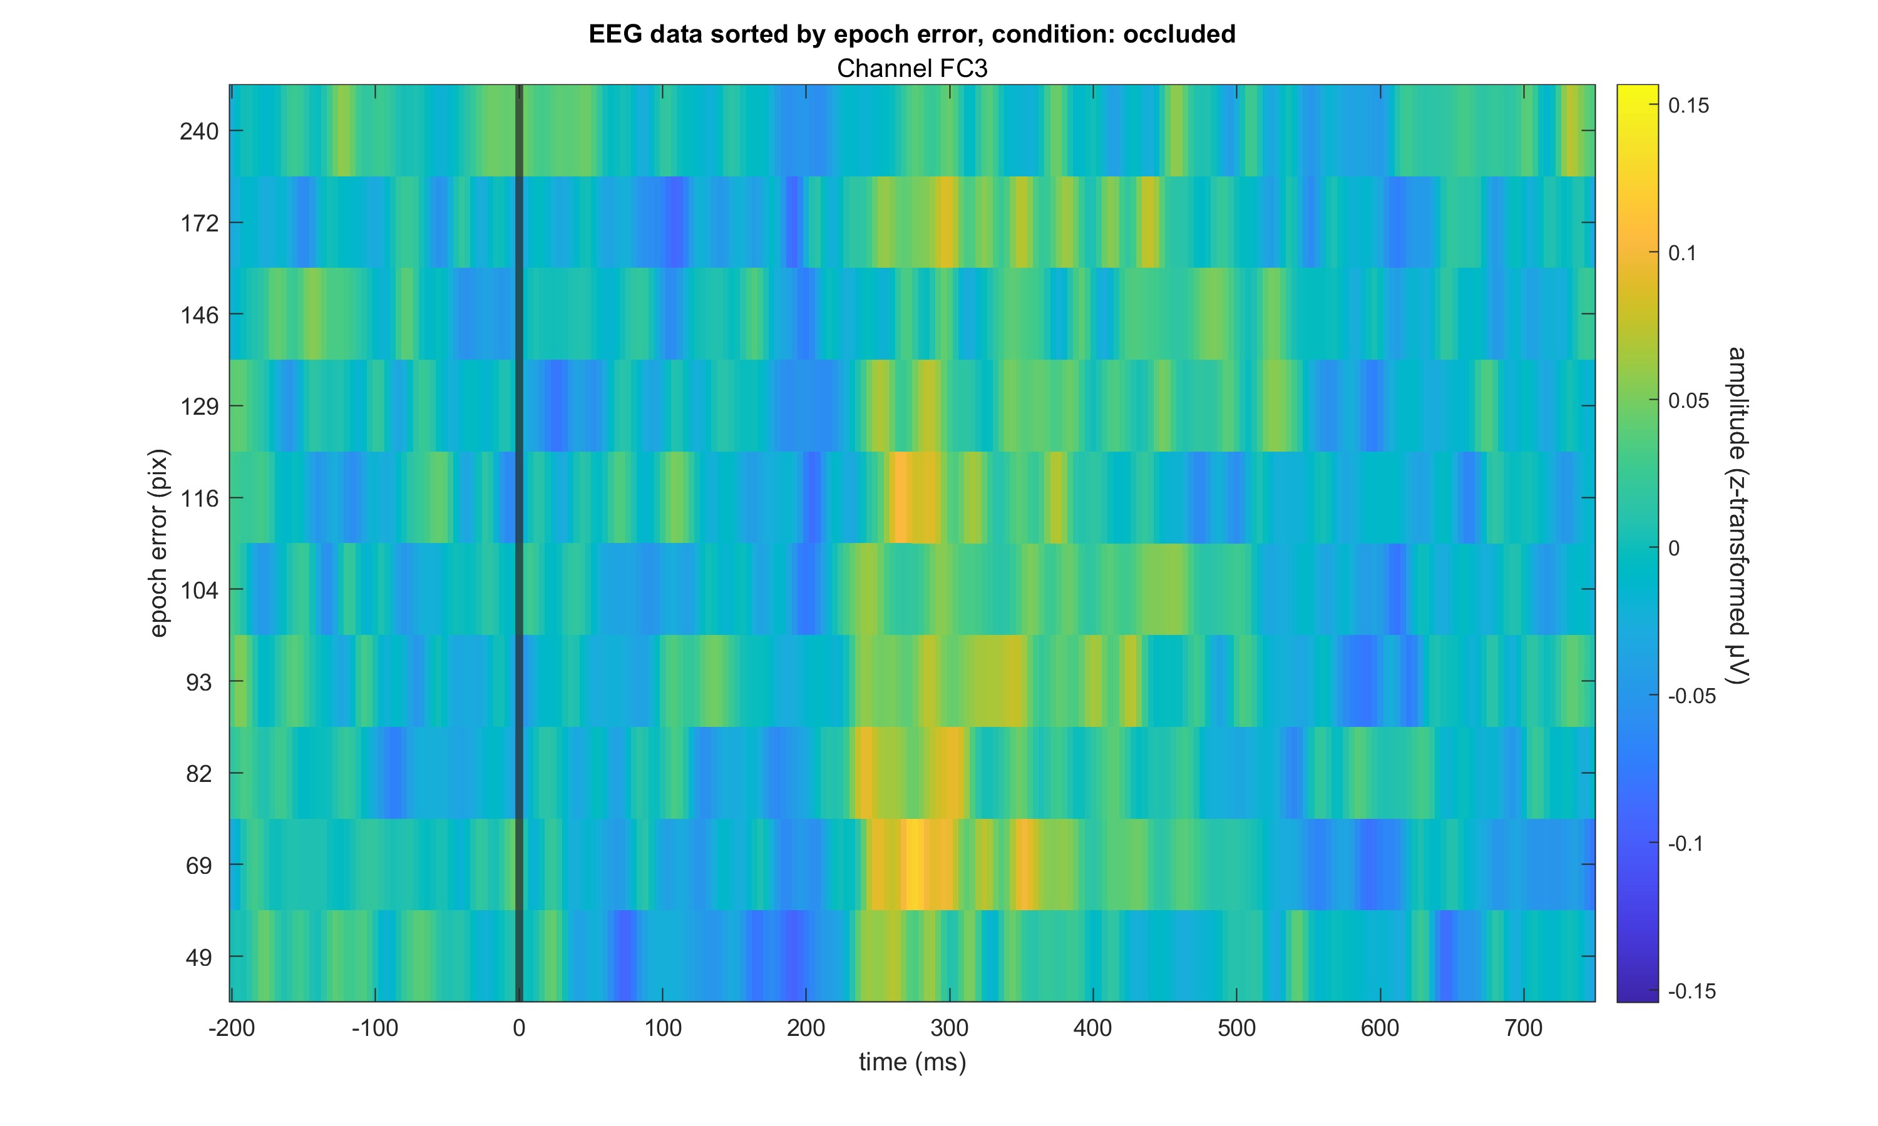

Slide 9
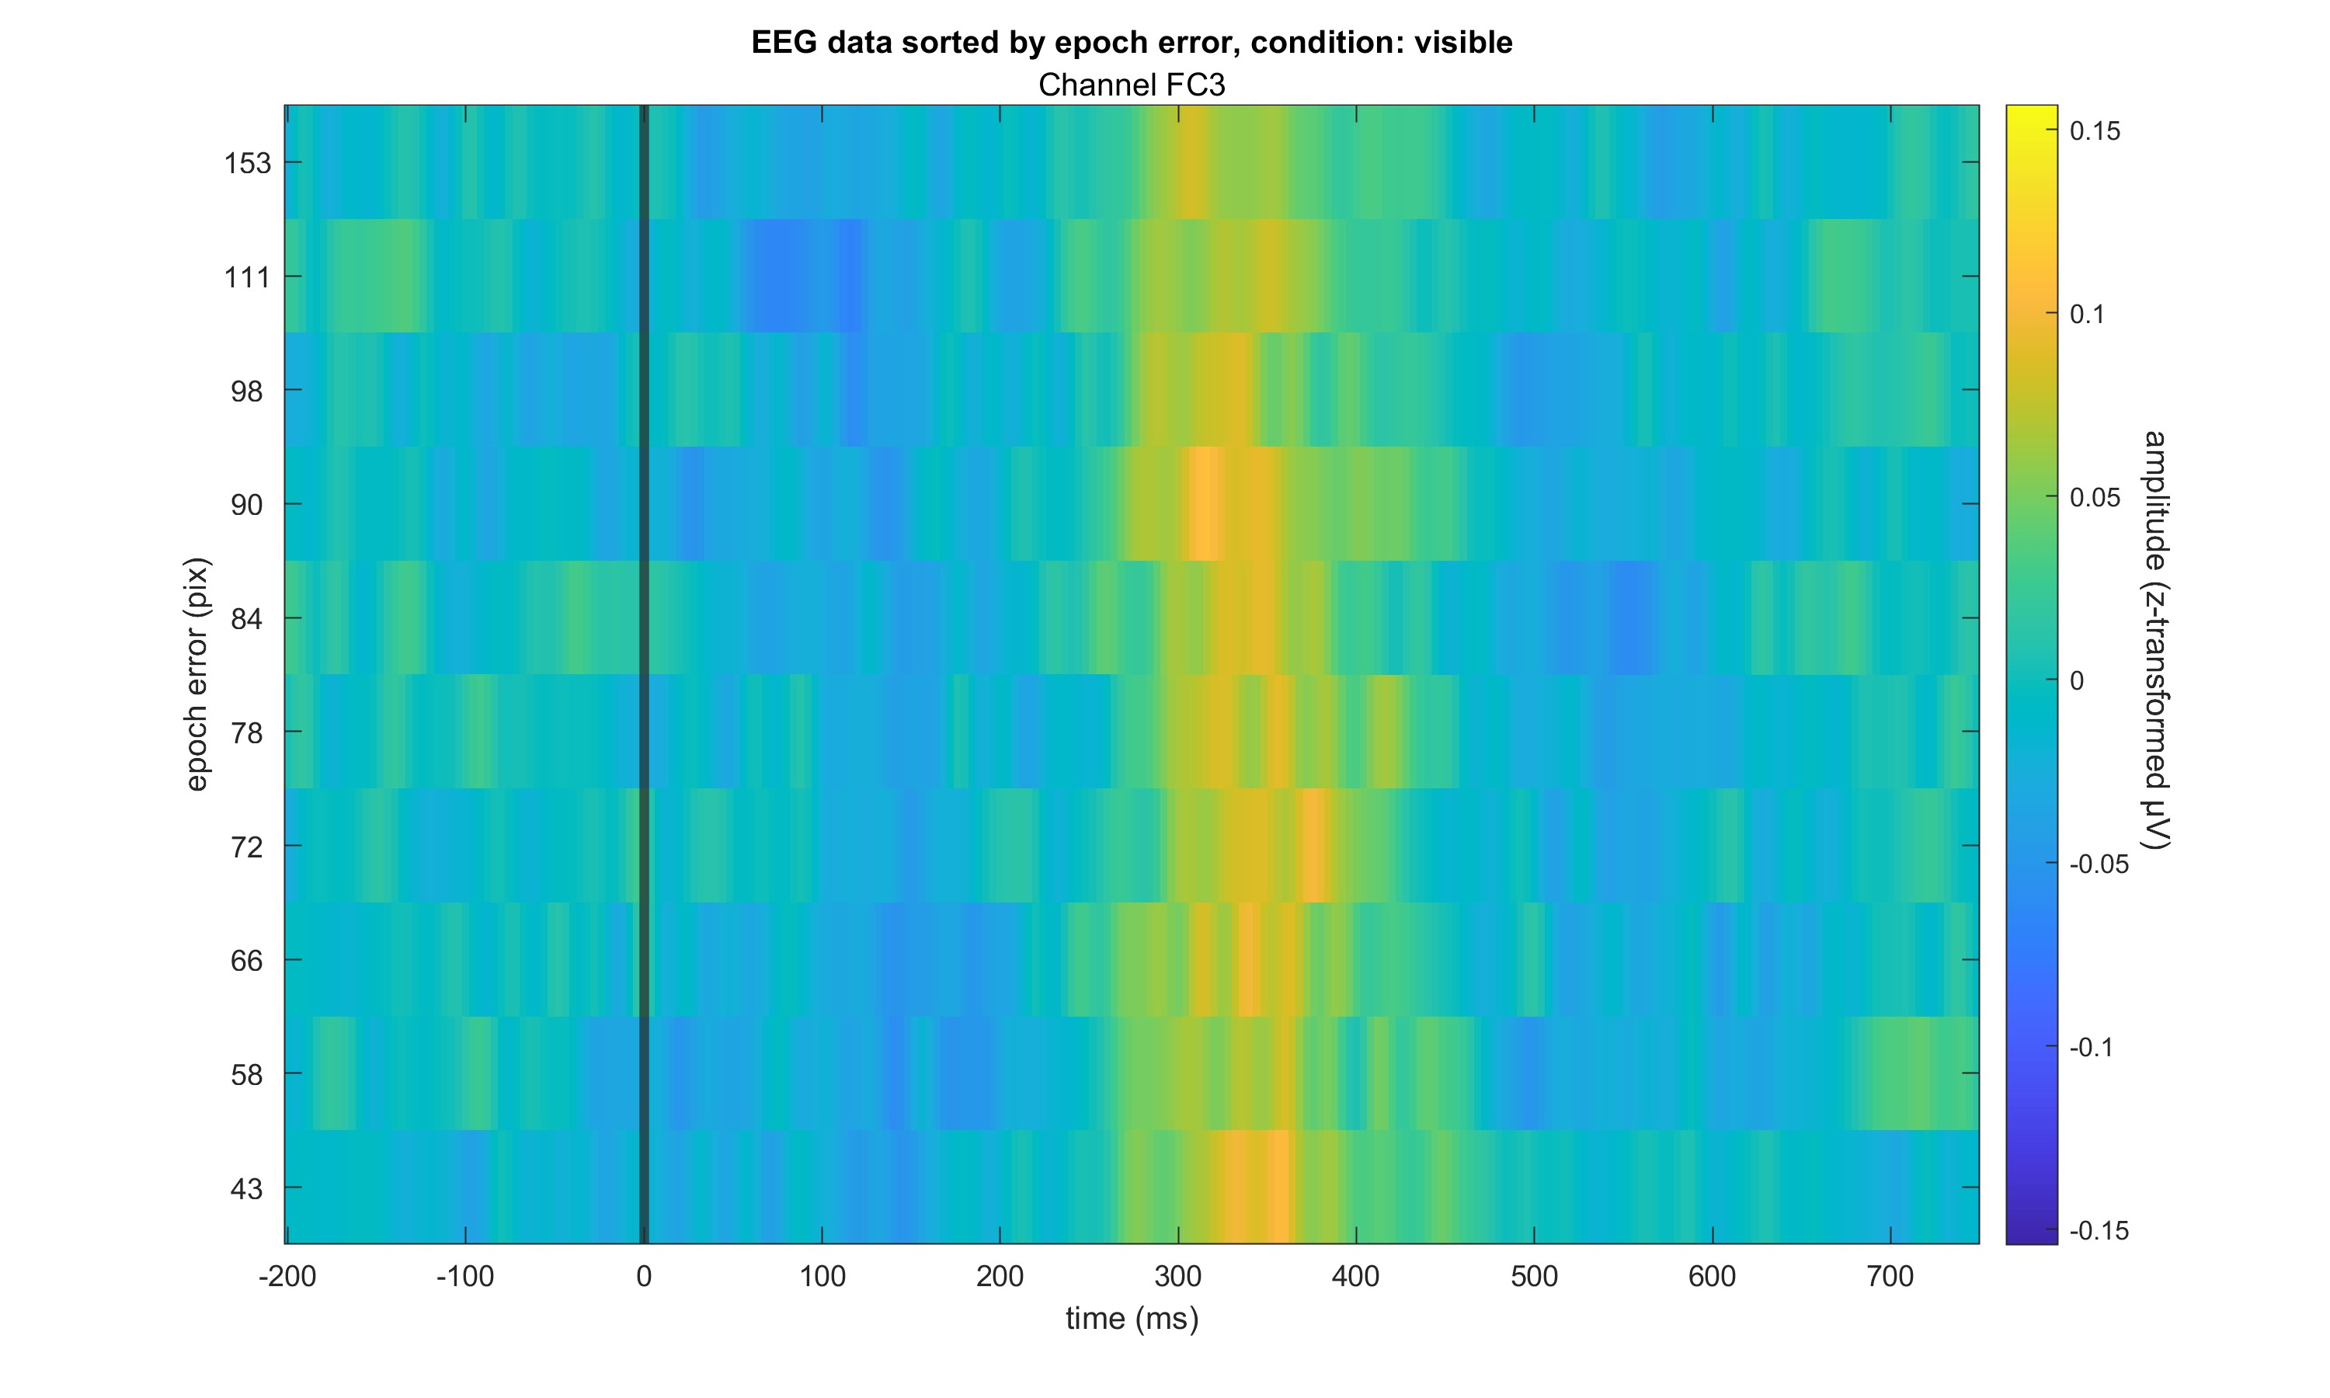

Slide 10
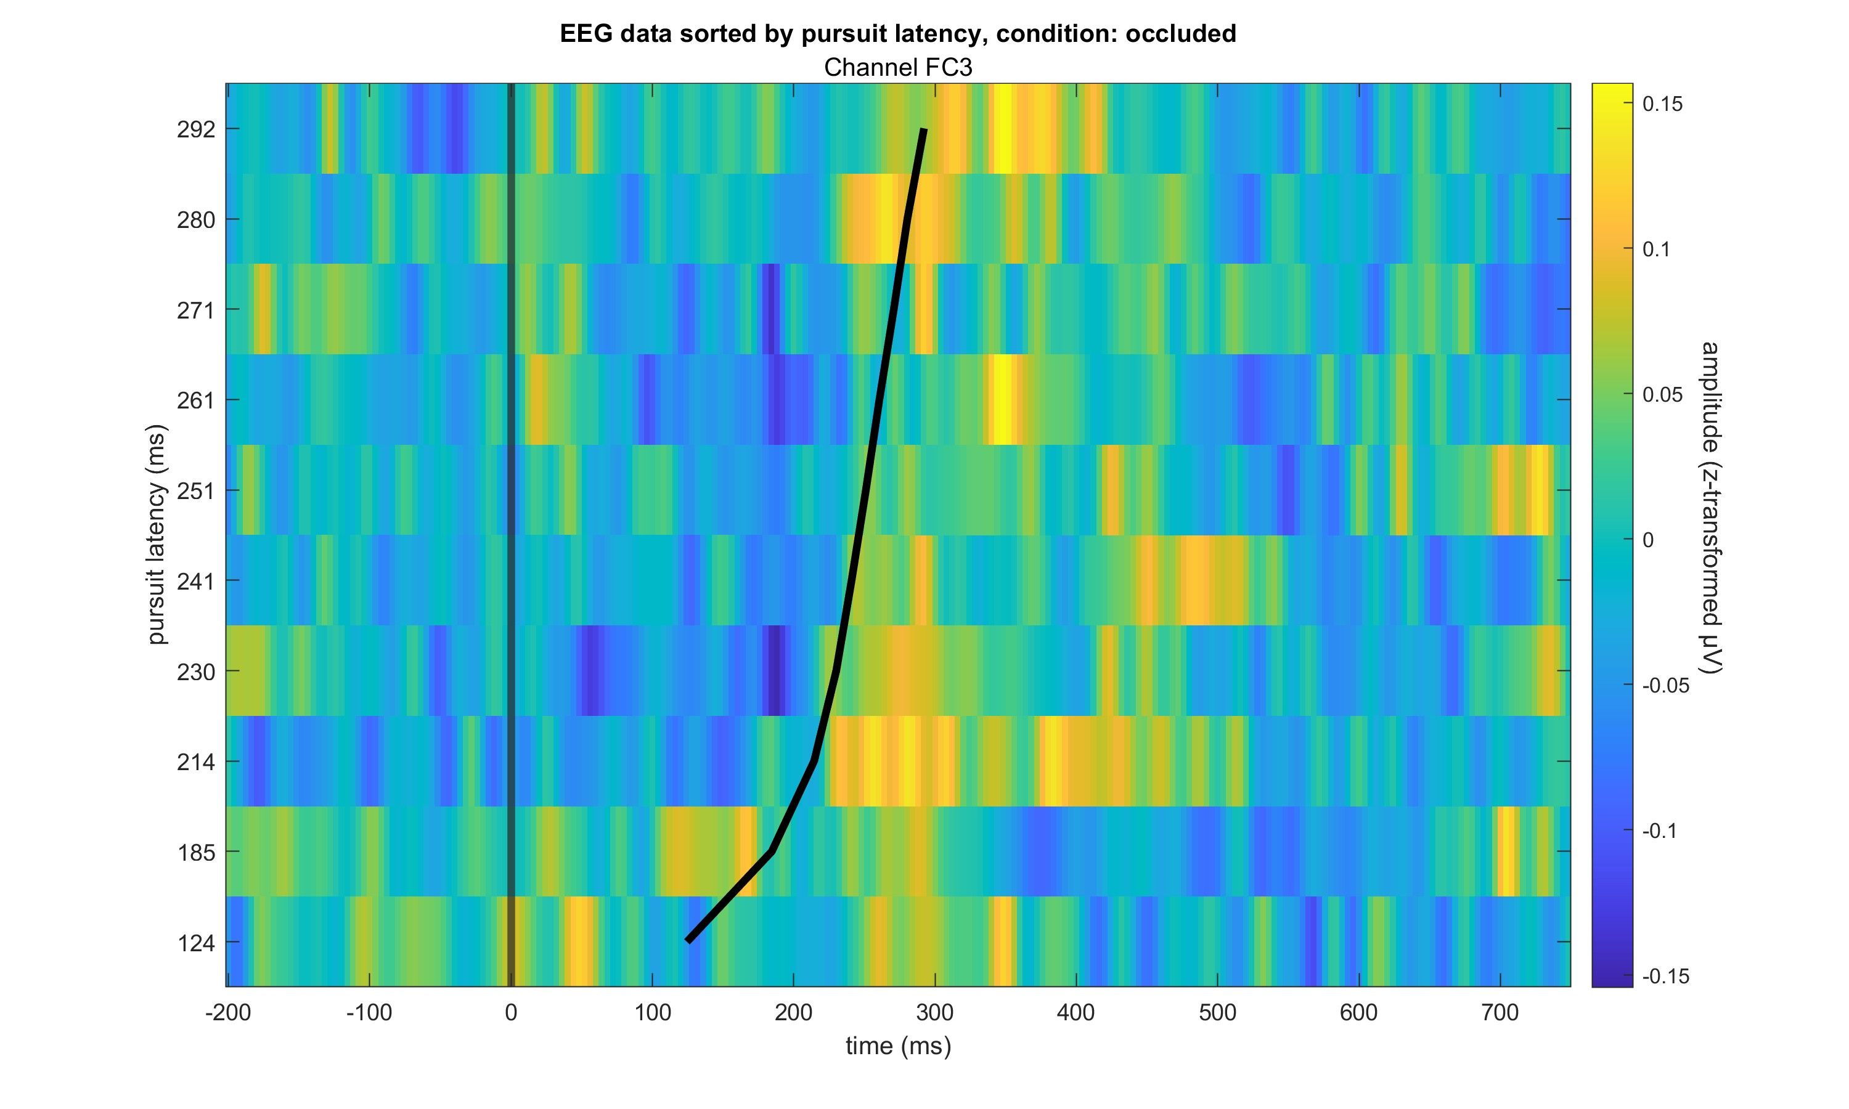

Slide 11
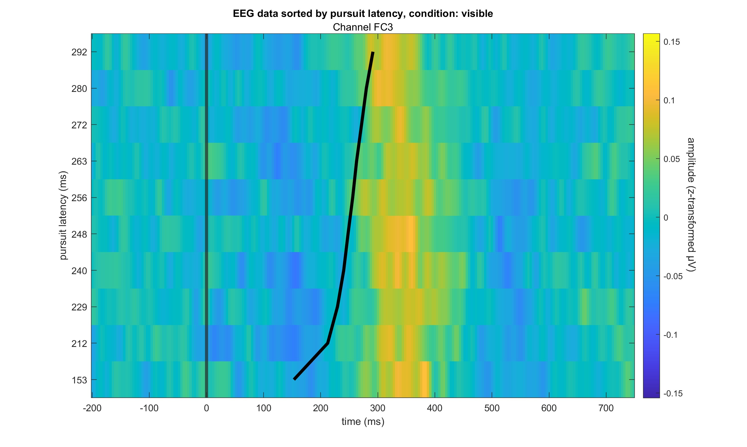

Slide 12
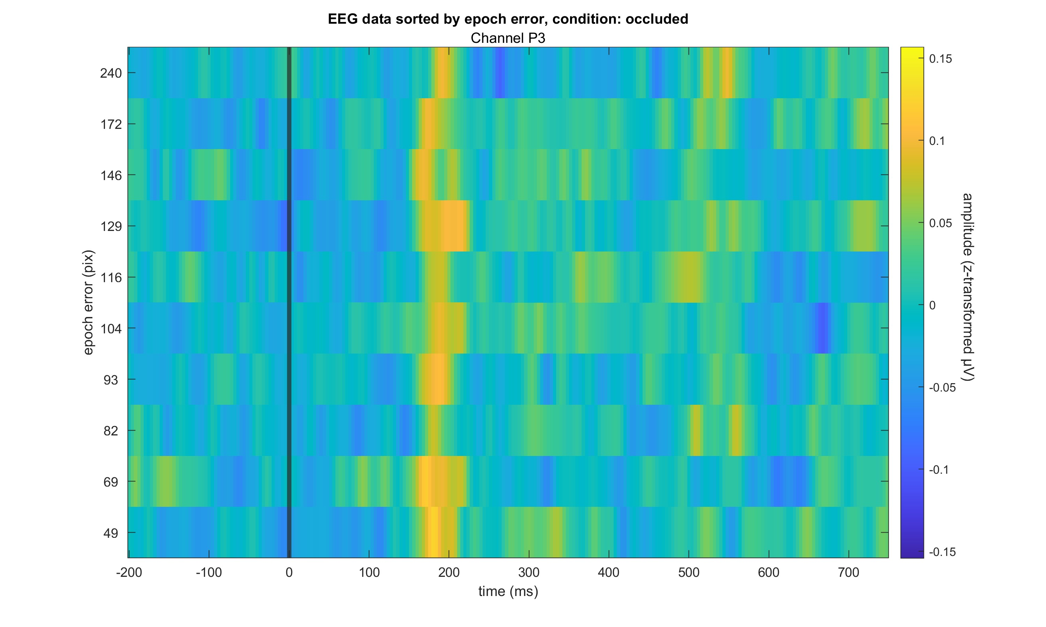

Slide 13
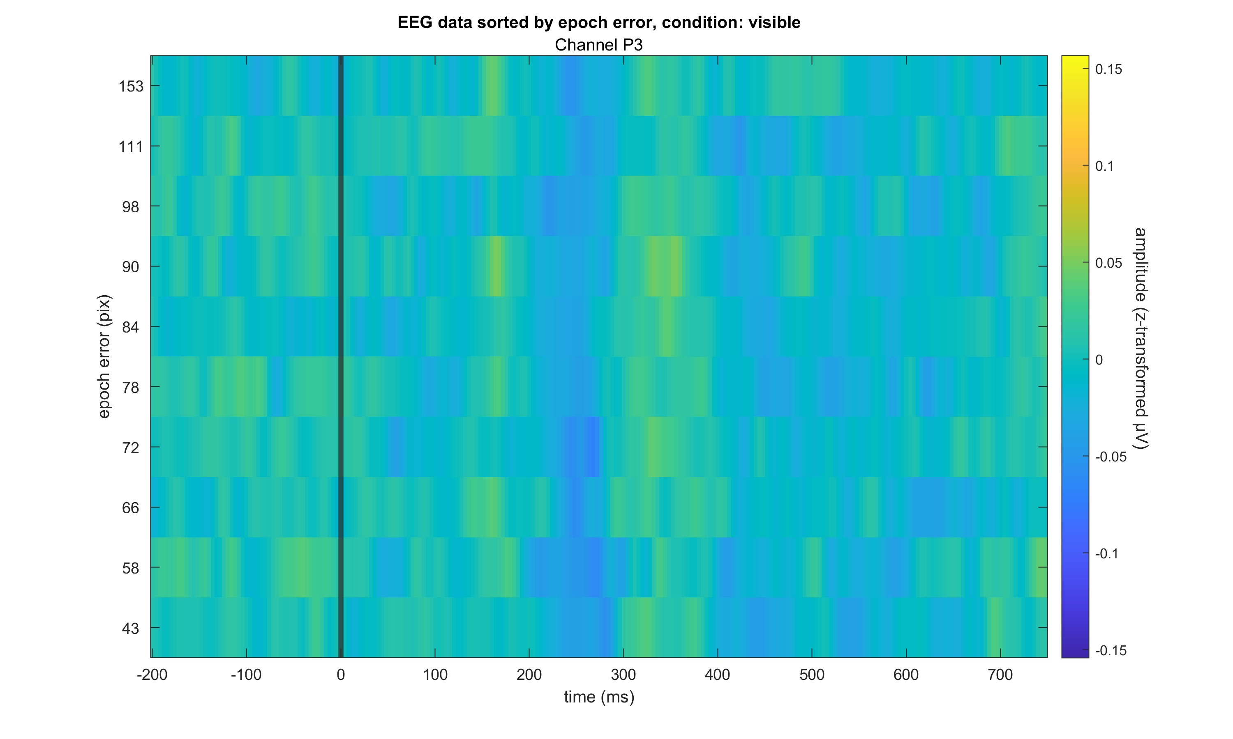

Slide 14
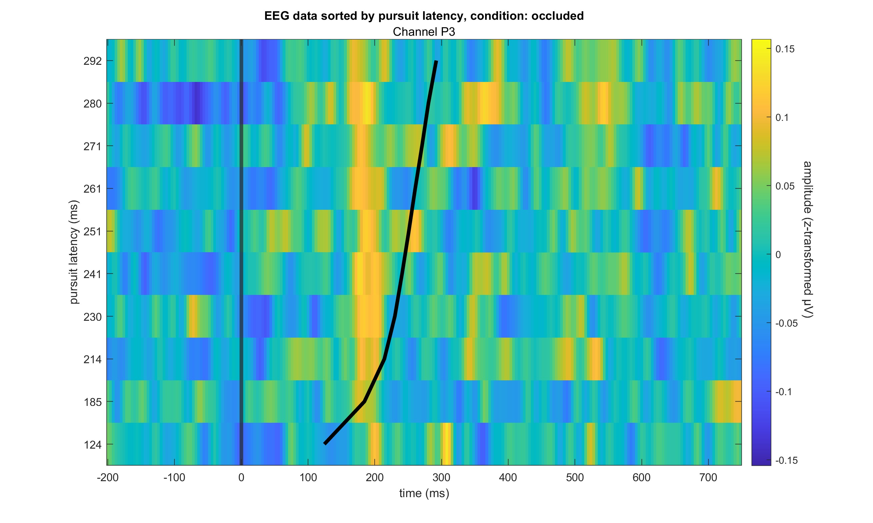

Slide 15
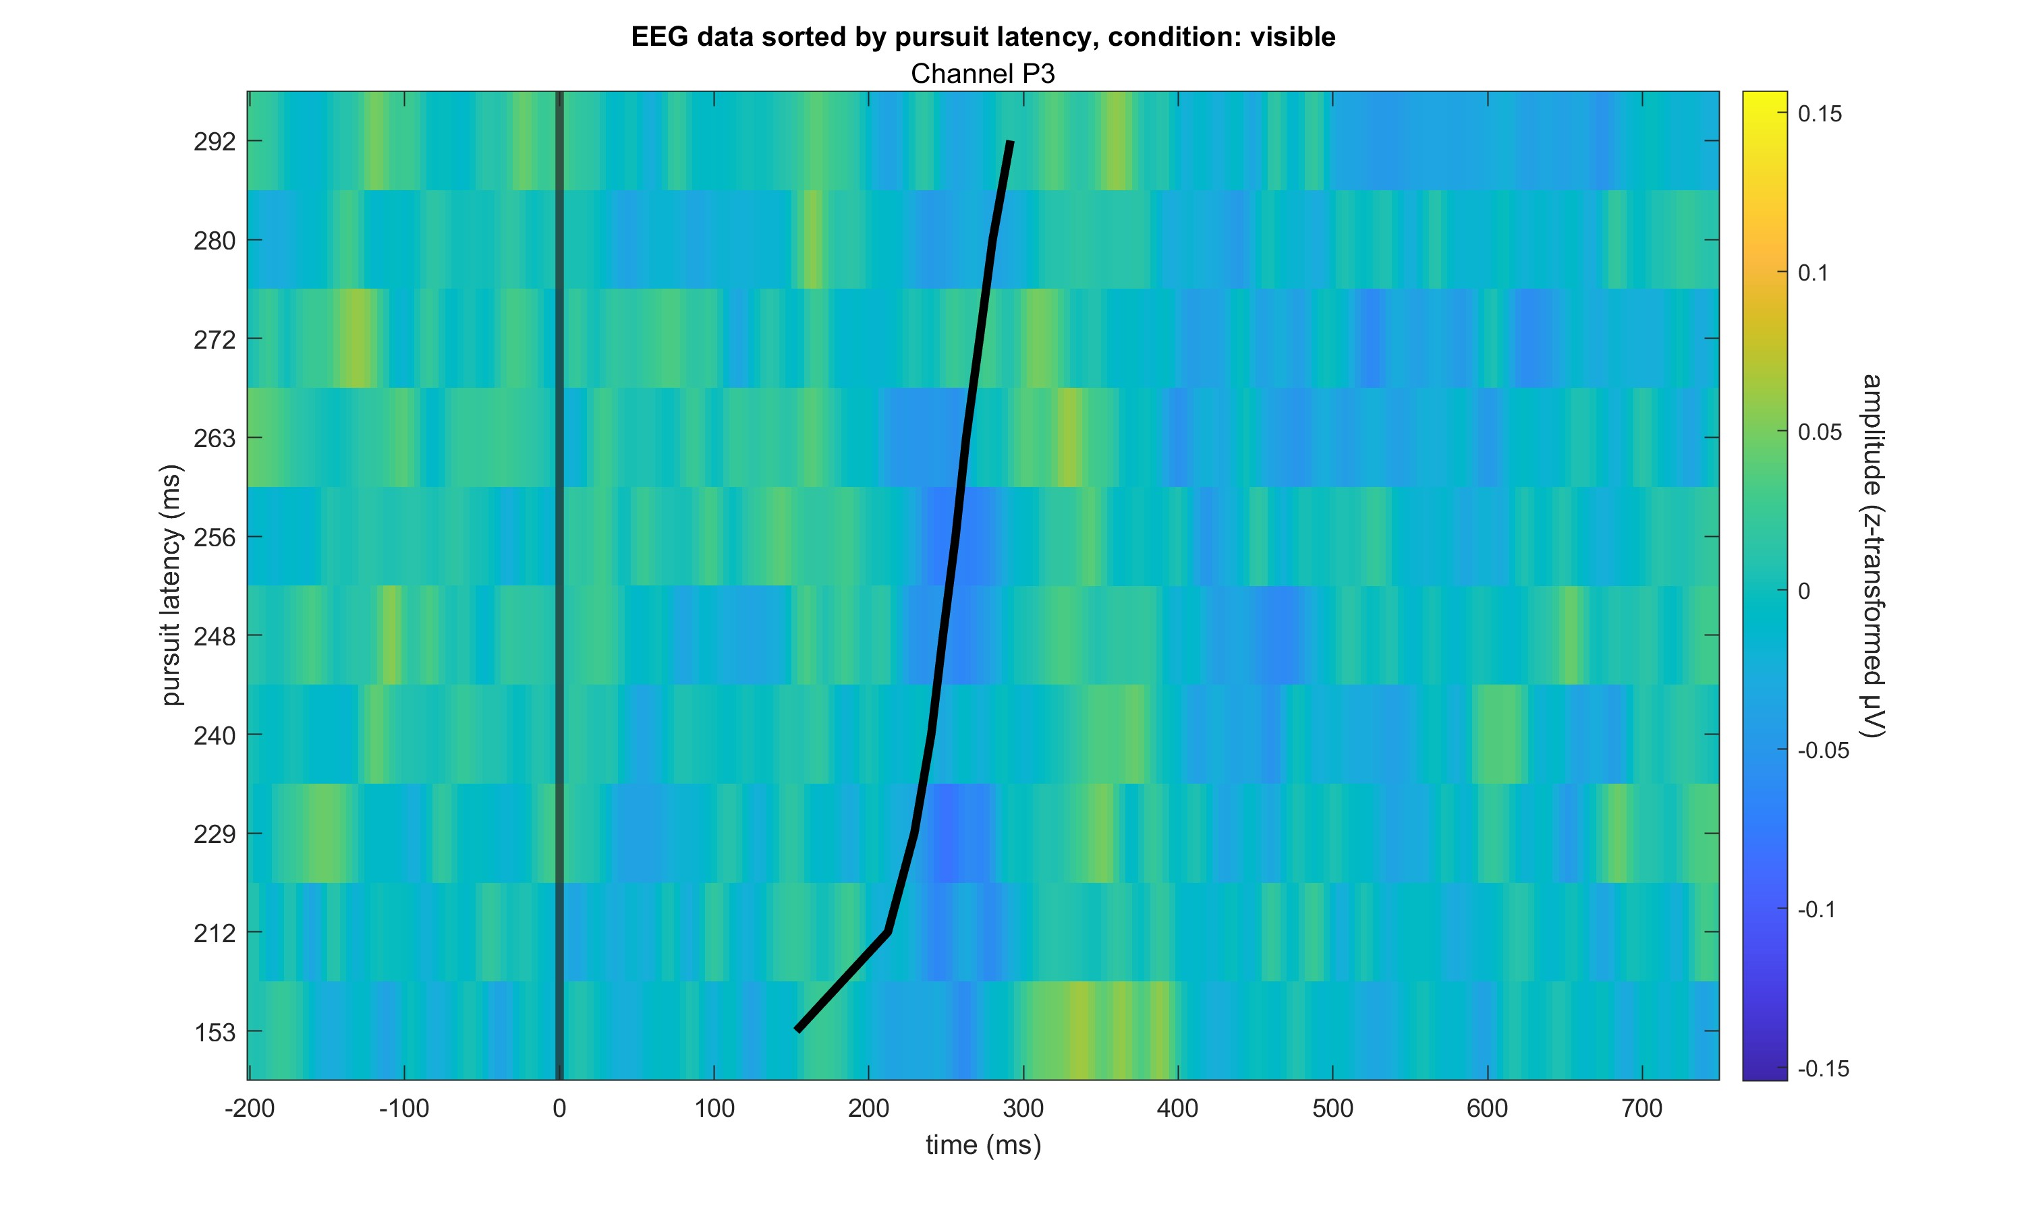

Slide 16
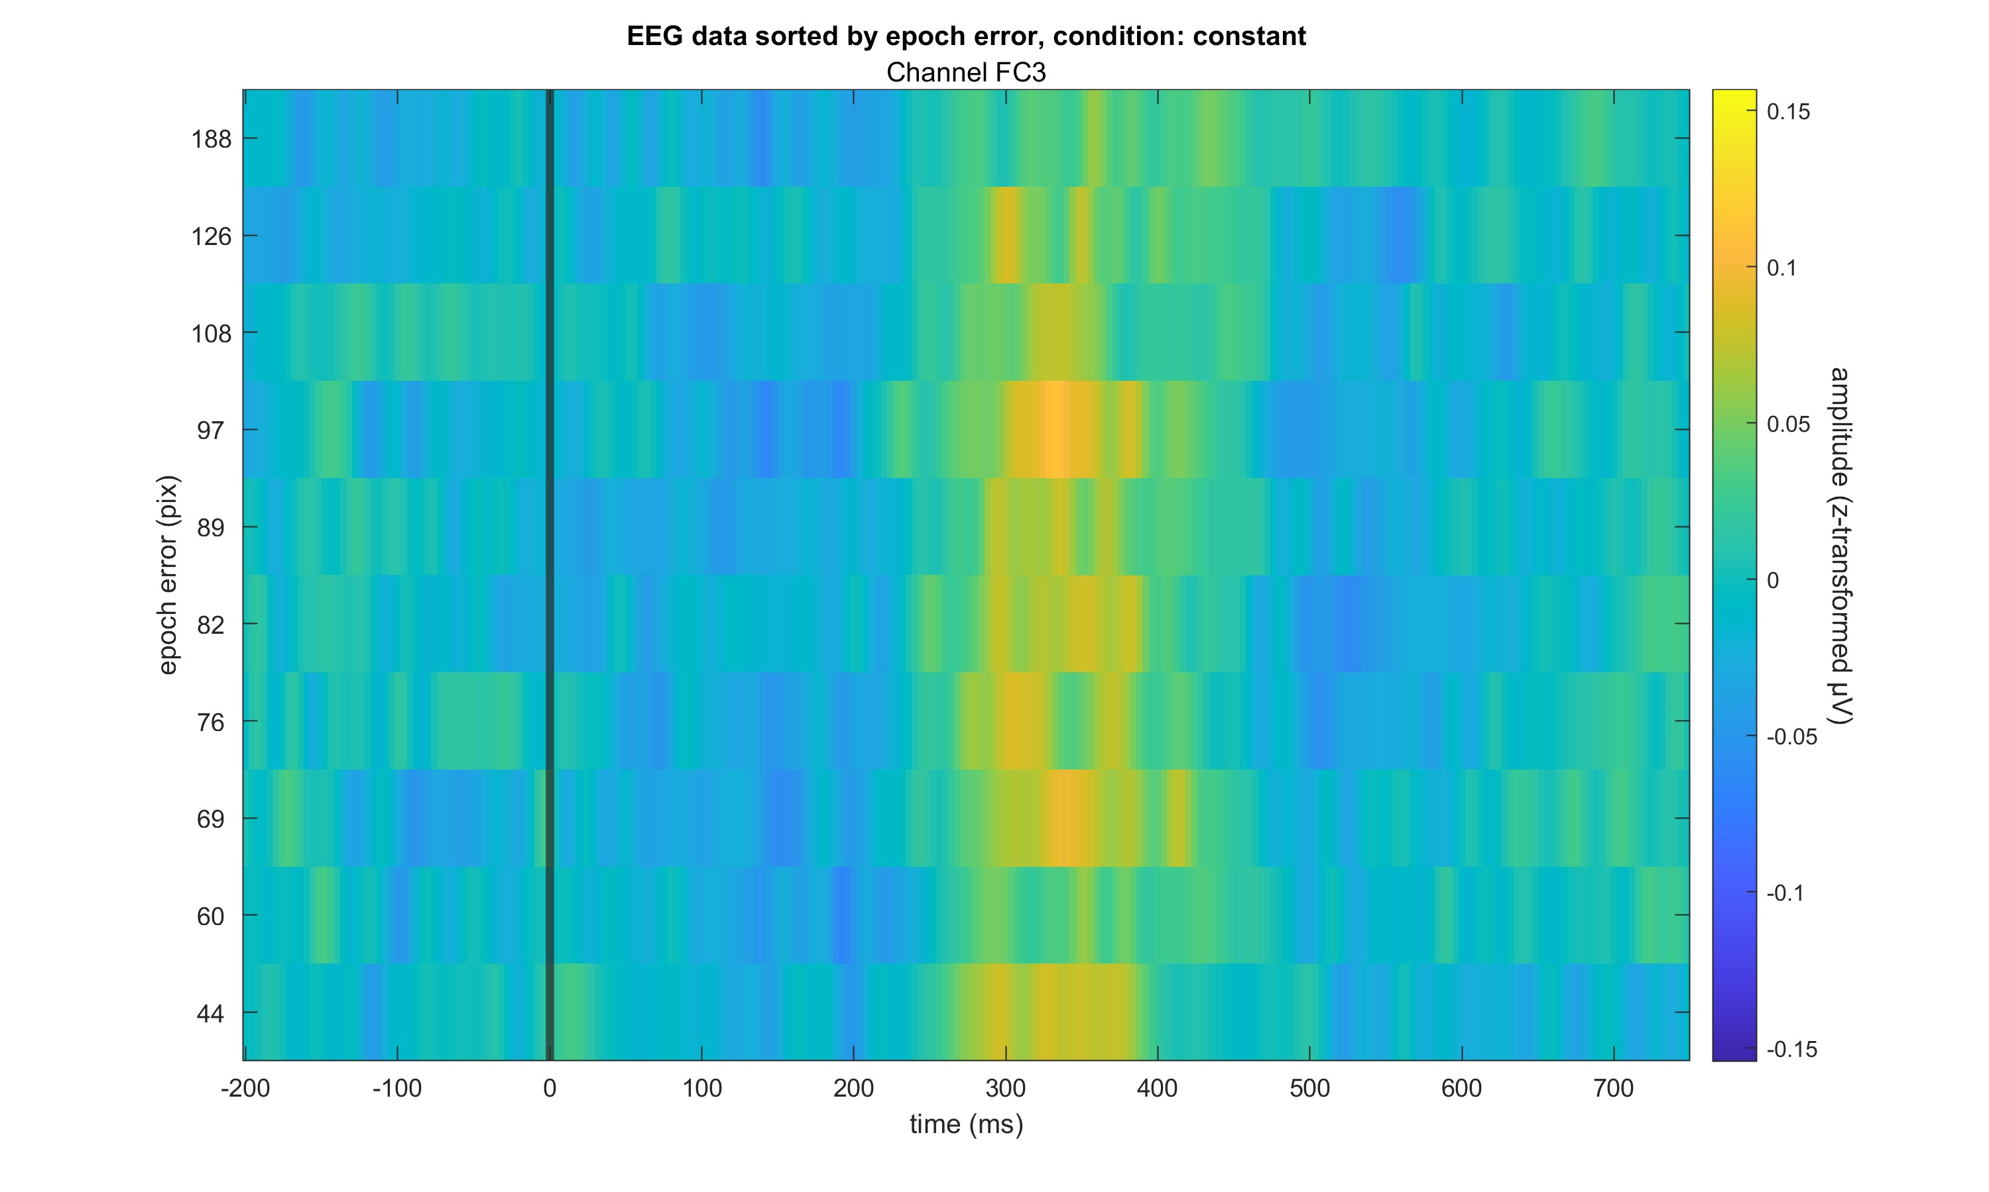

Slide 17
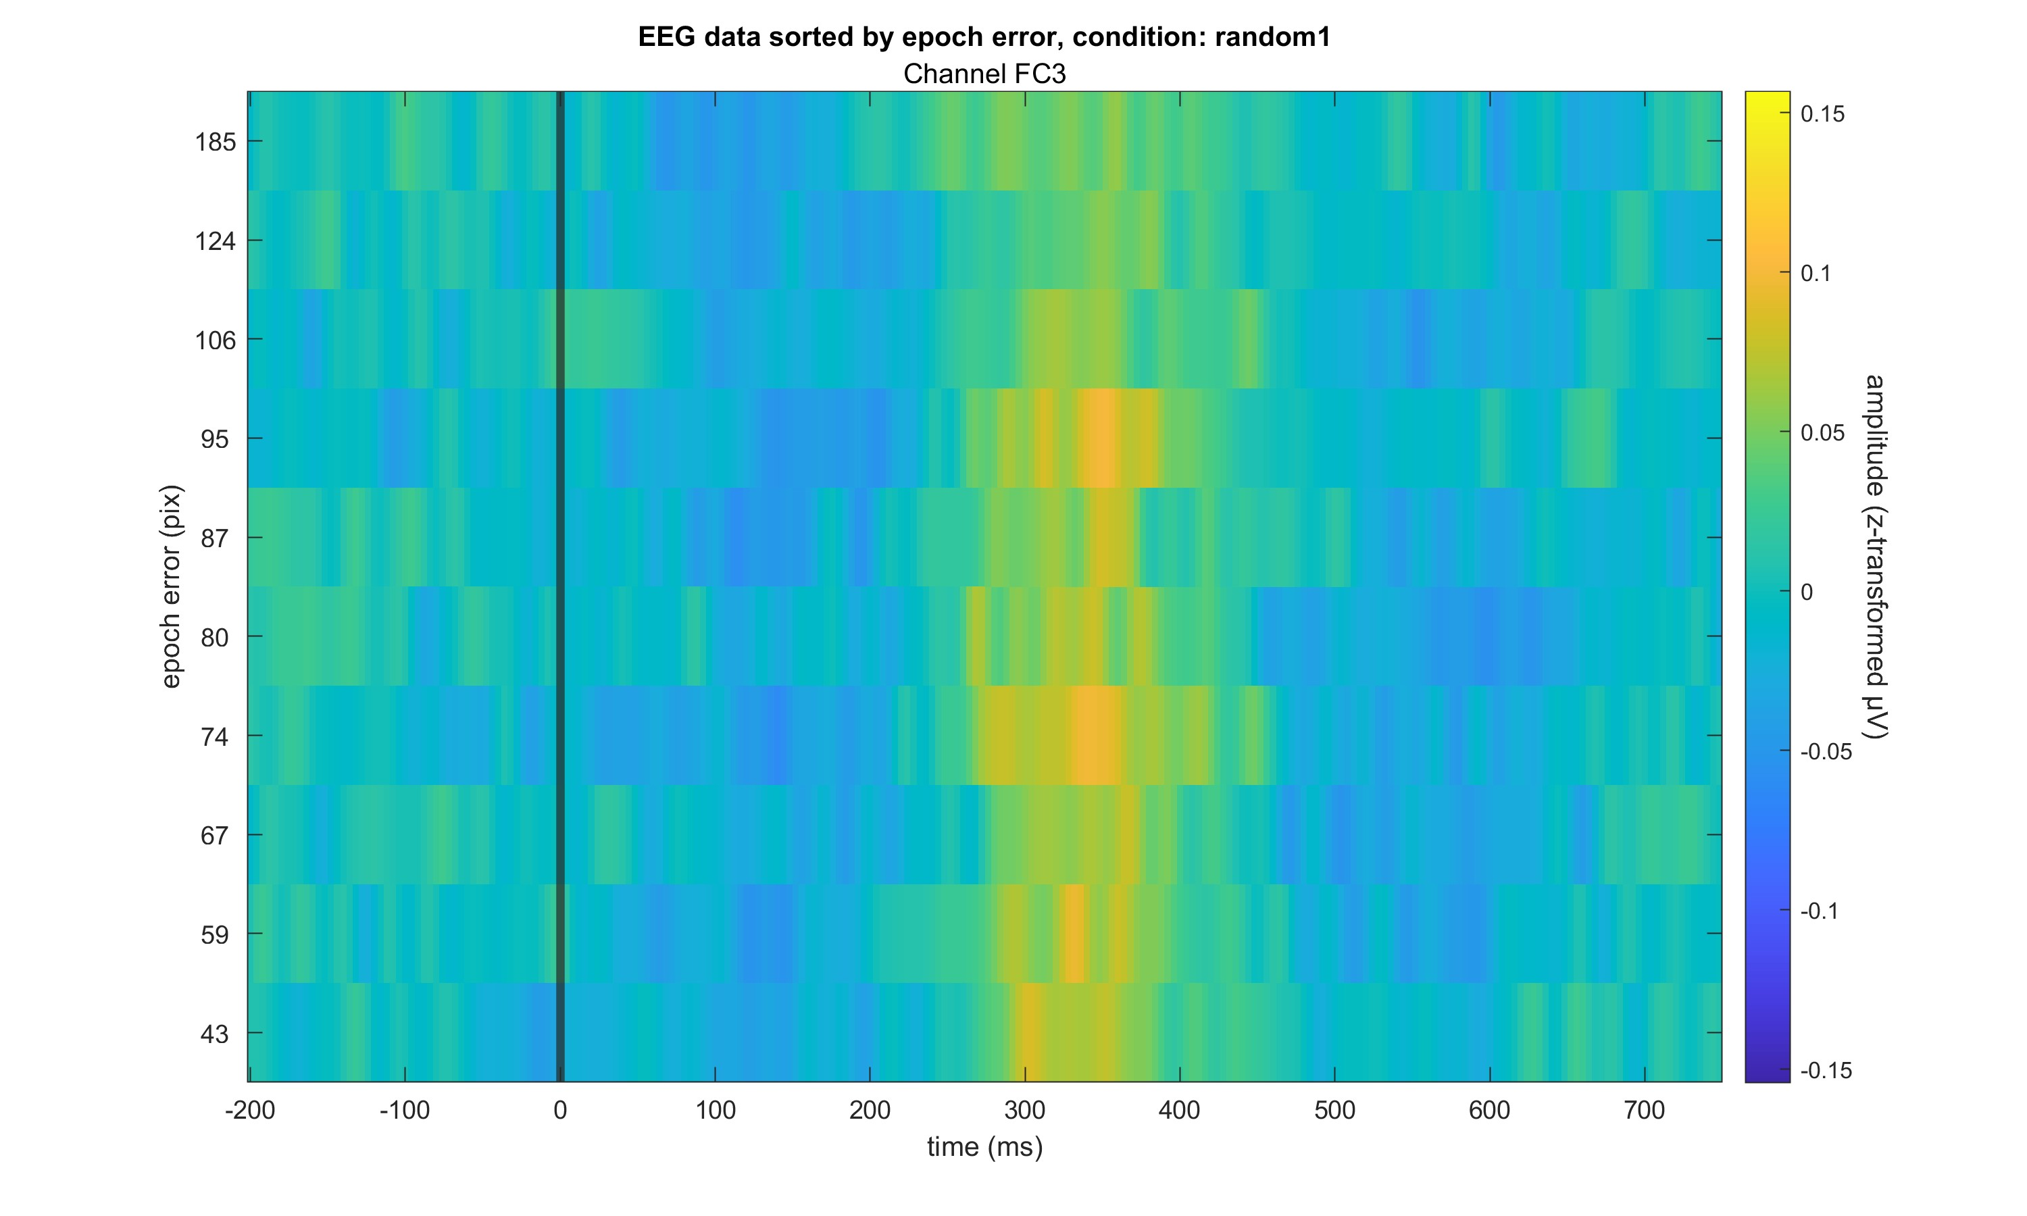

Slide 18
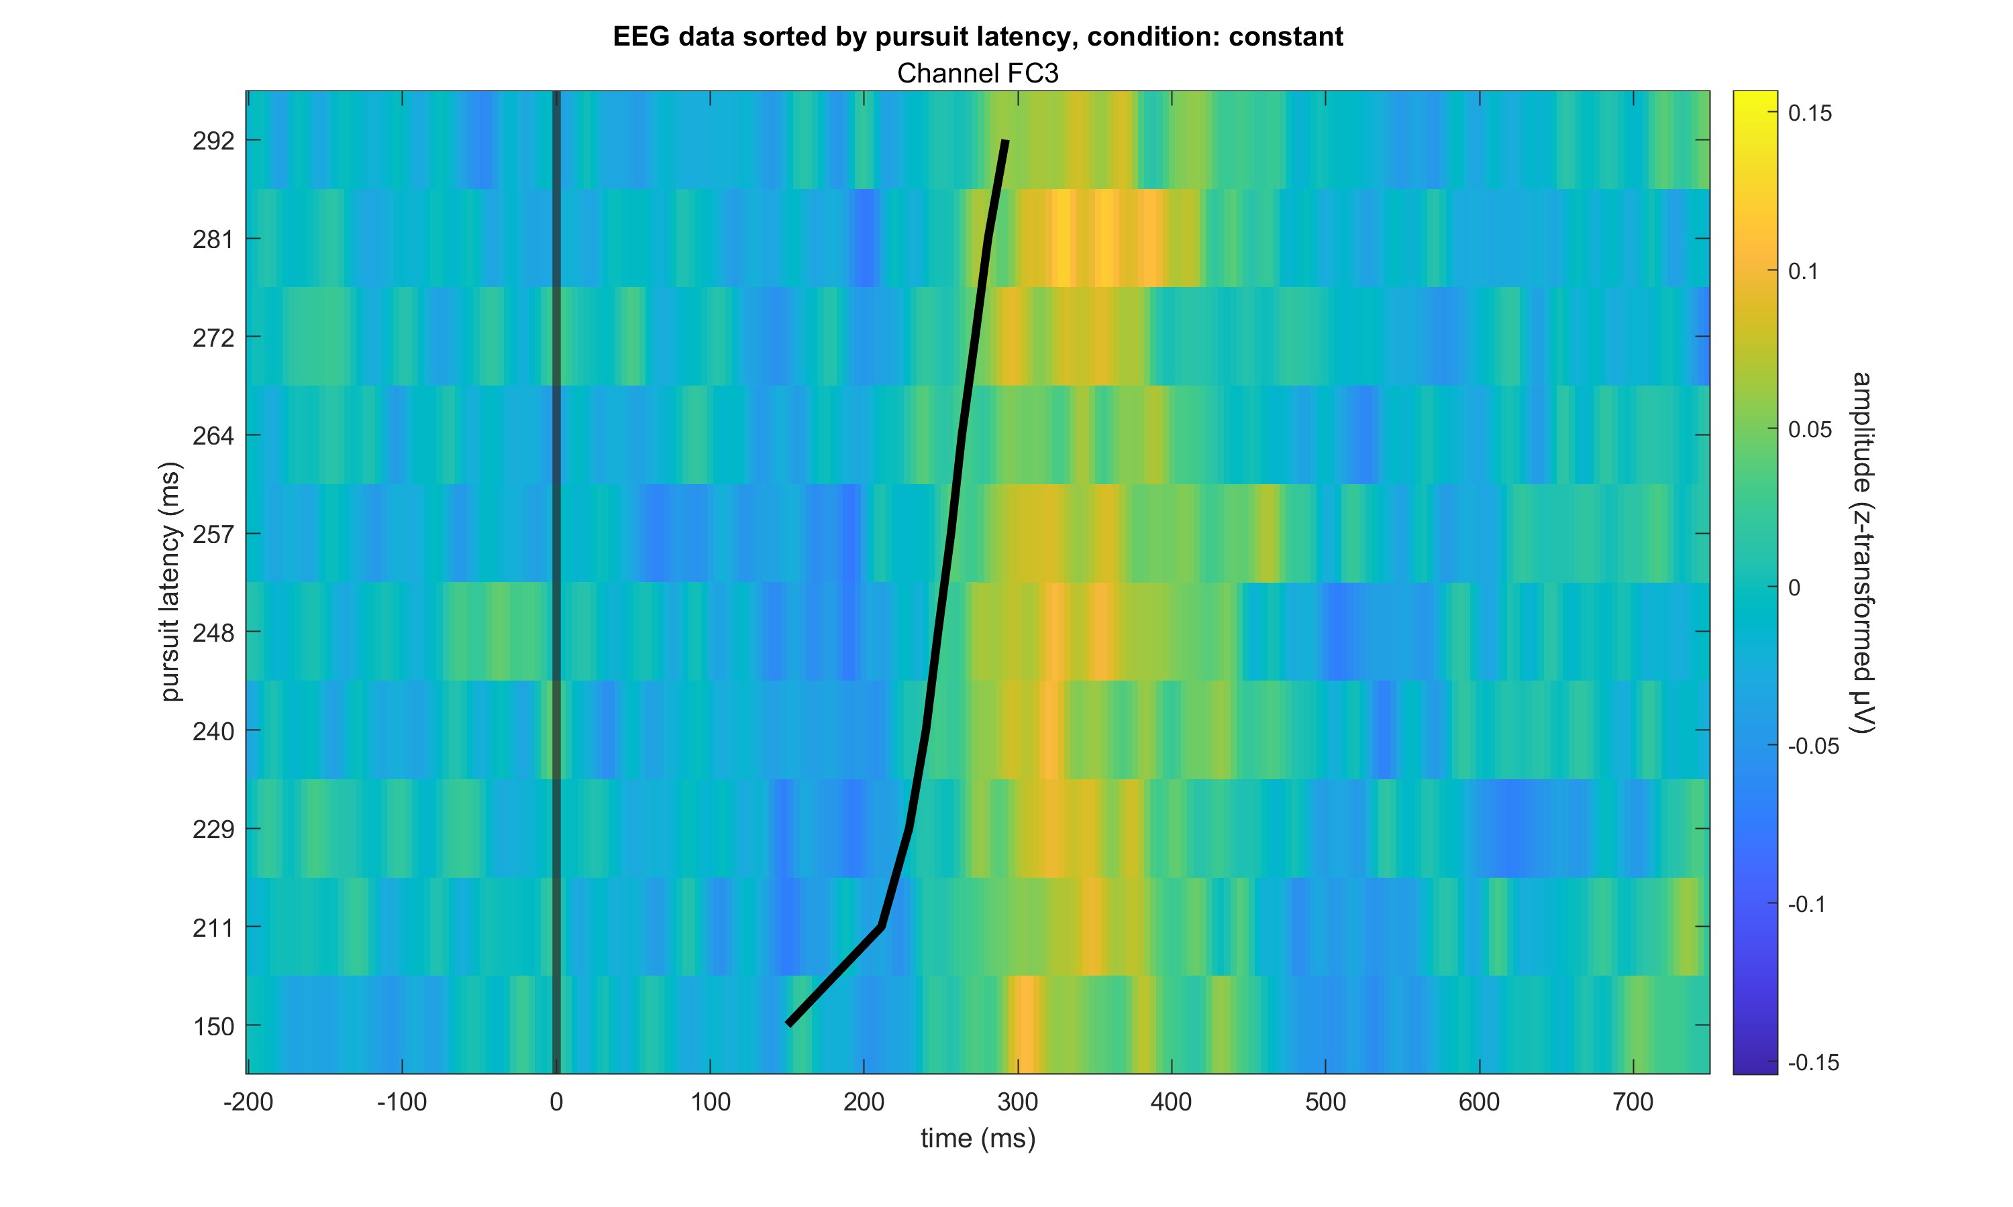

Slide 19
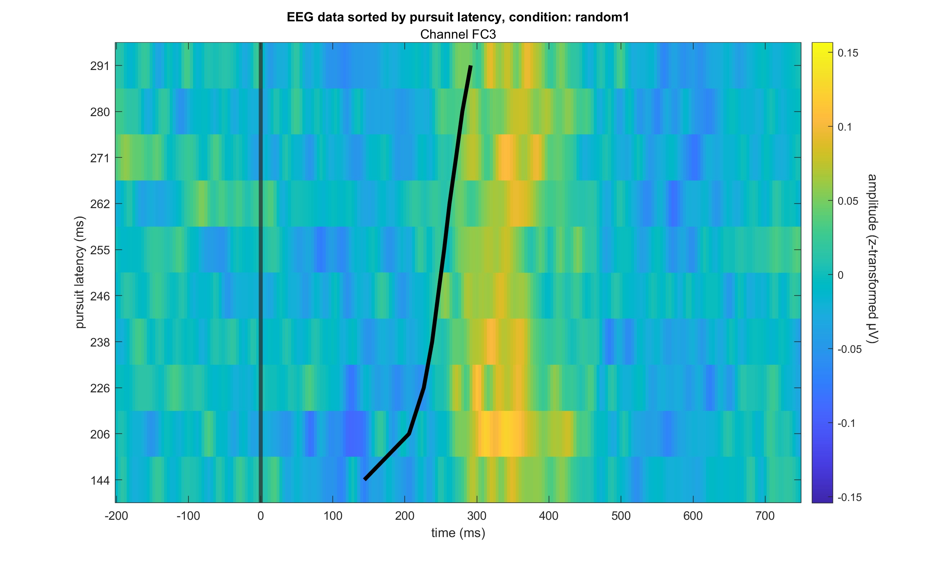

Slide 20
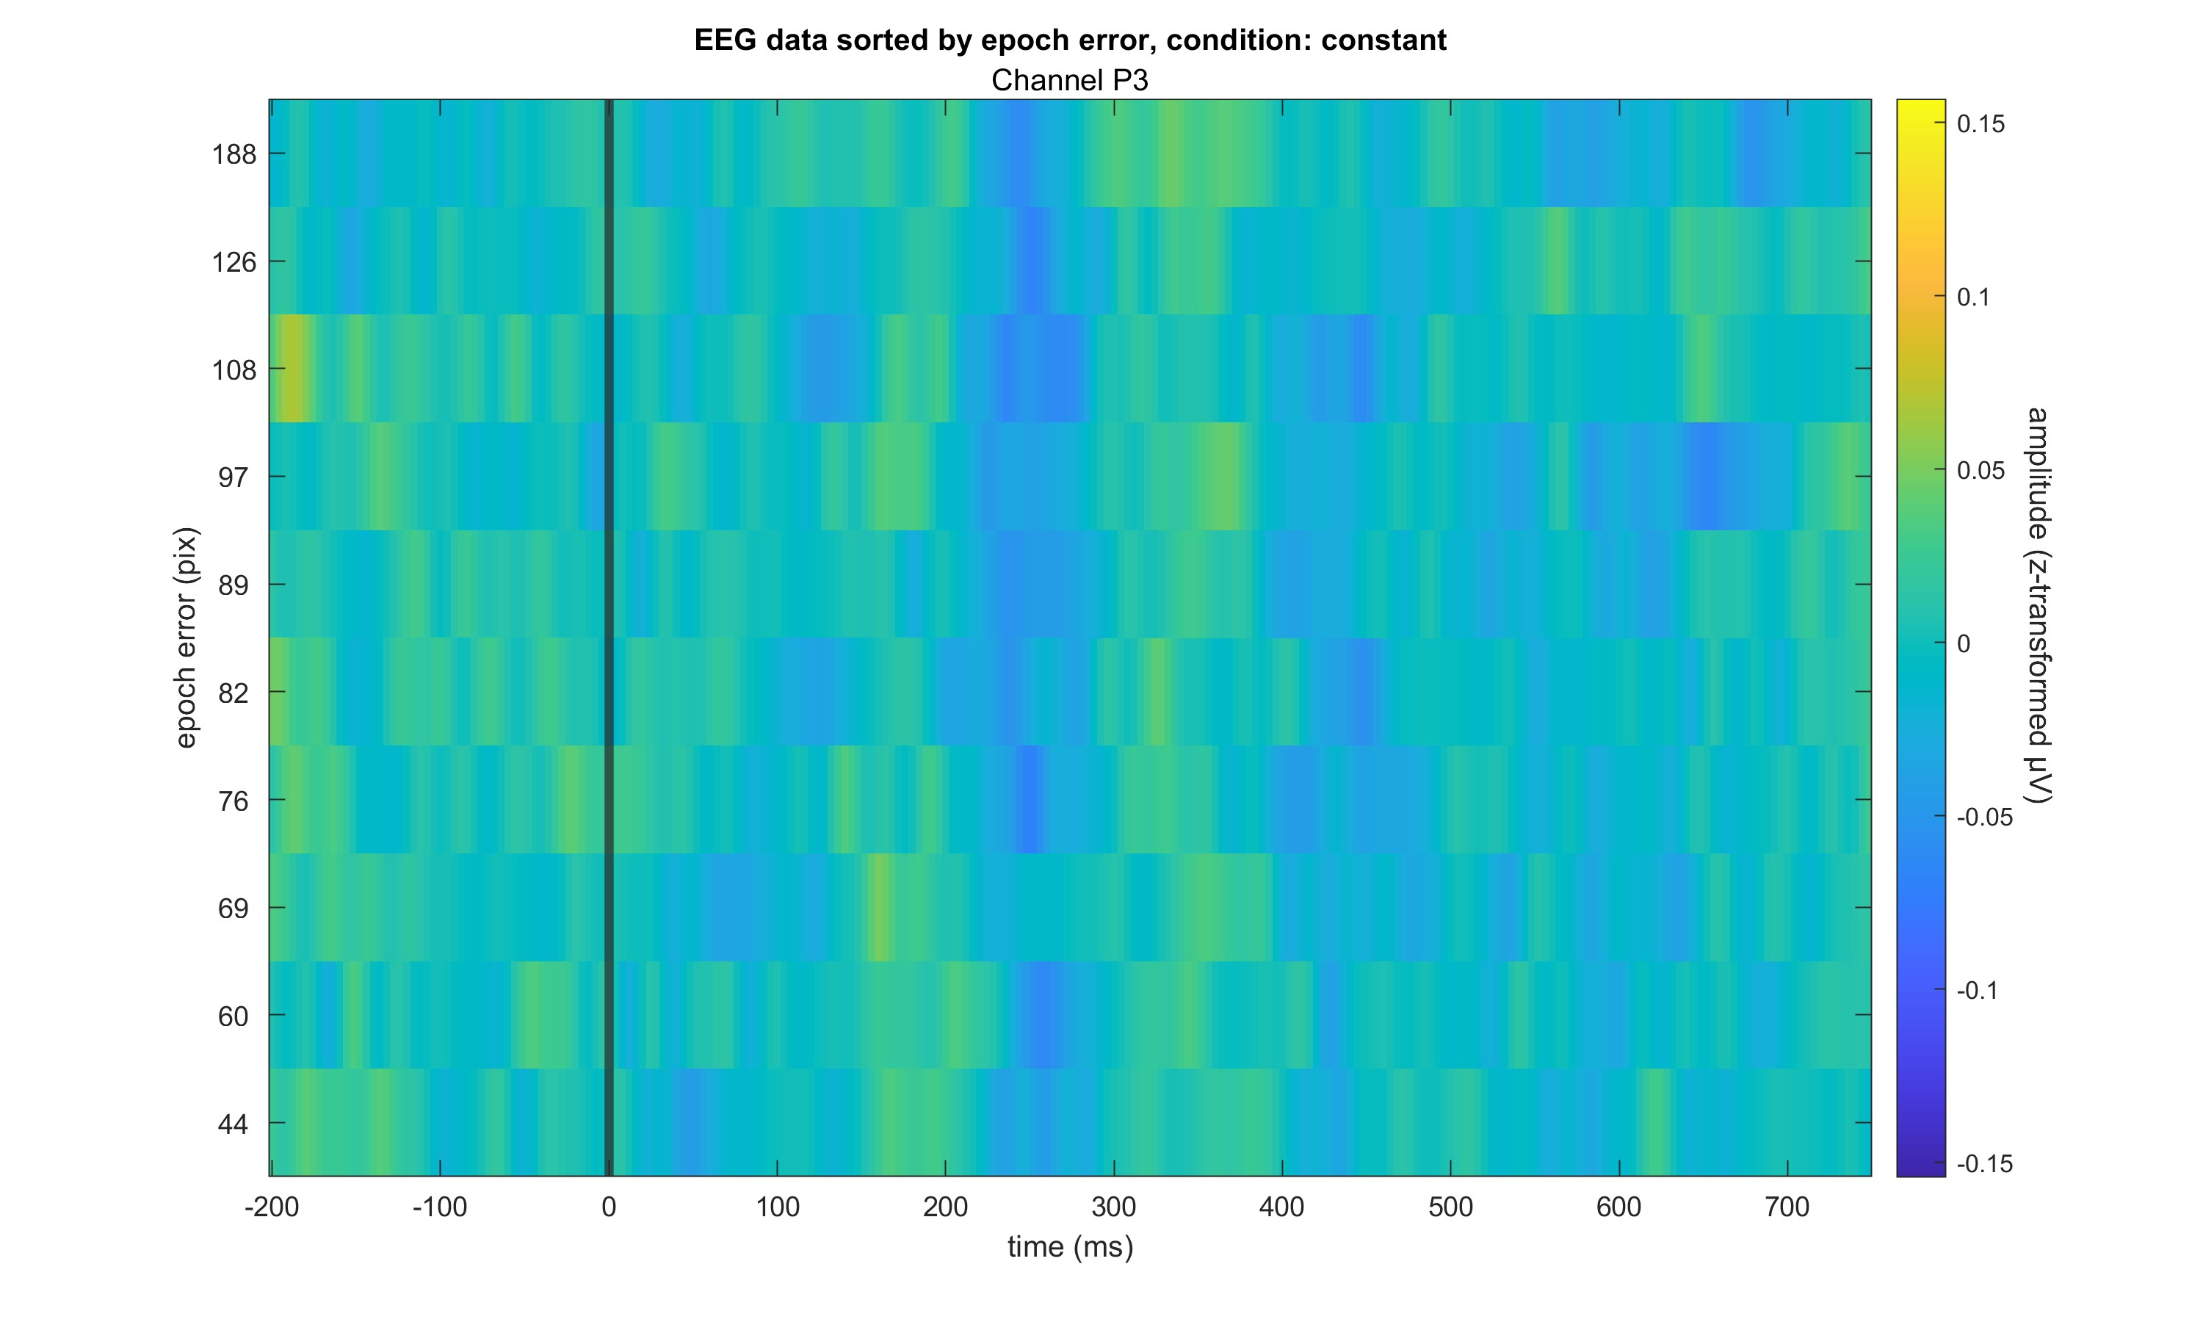

Slide 22
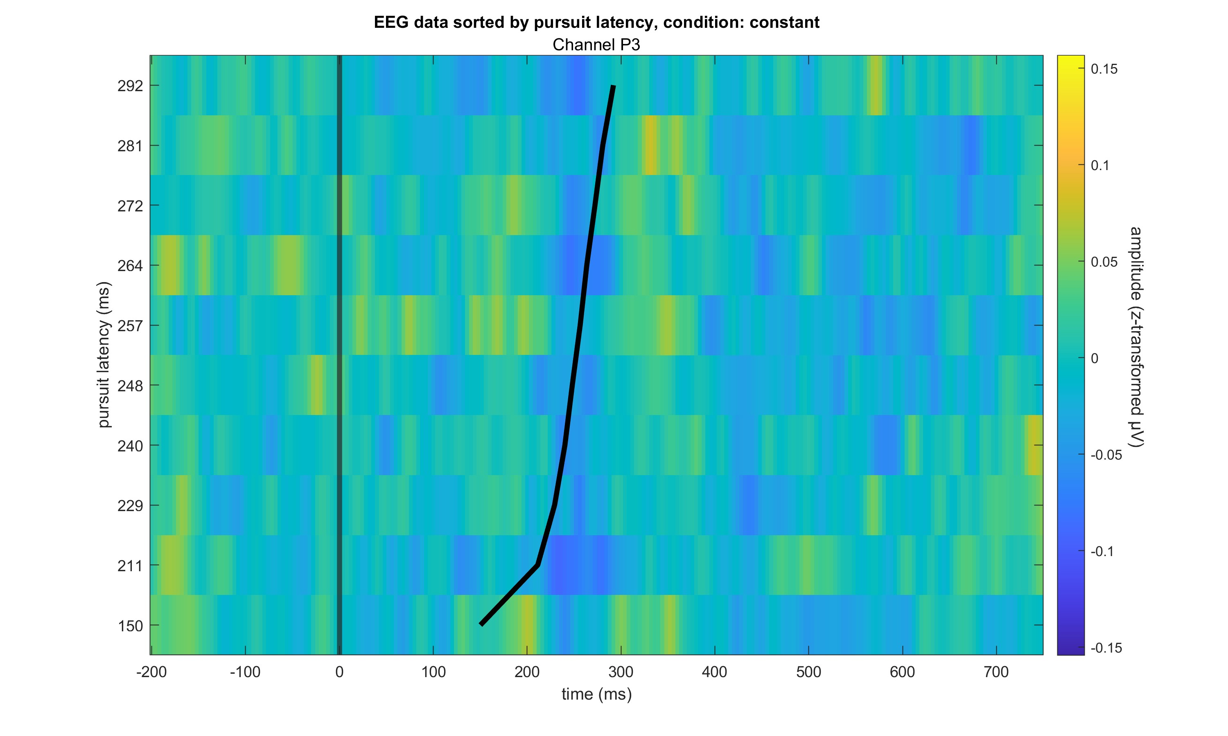

Slide 23
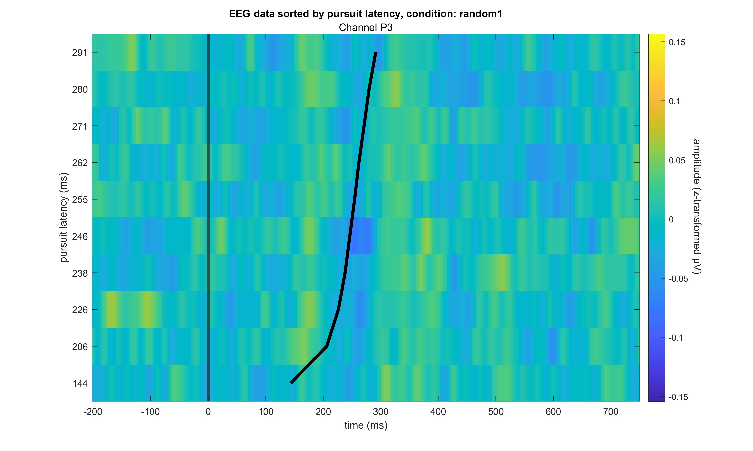

Slide 24
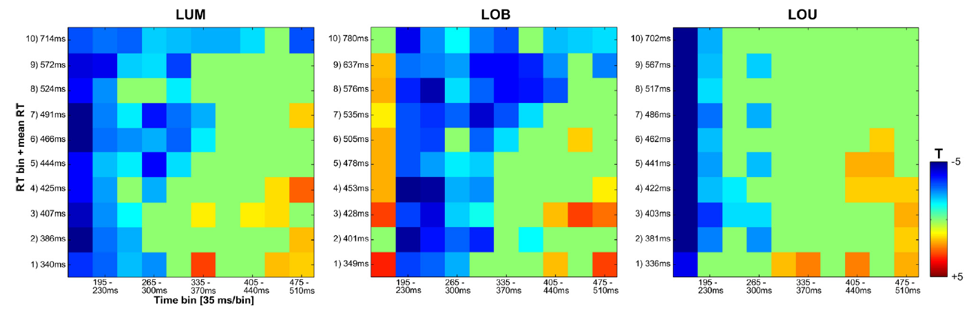
Role Model for Analysis: Paper by Sven

Slide 25
Hypothesis tests
Using the data prepared for the ERP images…
(Sorted all eeg data (all subjects, all trials) in vincentiles (10 bins) for the two error measures pursuit latency and epoch error
For each condition separately
One electrode at a time (FC3 and P3))
Split the epoched eeg data in 100 ms to 600 ms bins (10 bins)
Calculated mean of eeg data per vincentile and bin, condition and electrode
Performed bootstrapping (1000 rep) on the distribution of means
Performed a one-sample t-test each per vincentile x bin combination for the all data condition and two-sample t-tests each per vincentile x bin combination for the contrasts occluded – visible and constant – random1
Per electrode (FC3 and P3)
Performed FDR correction for the 10*10 tests per contrast
TODO: adjust t-values for FDR as well
See images of test matrices

Slide 26
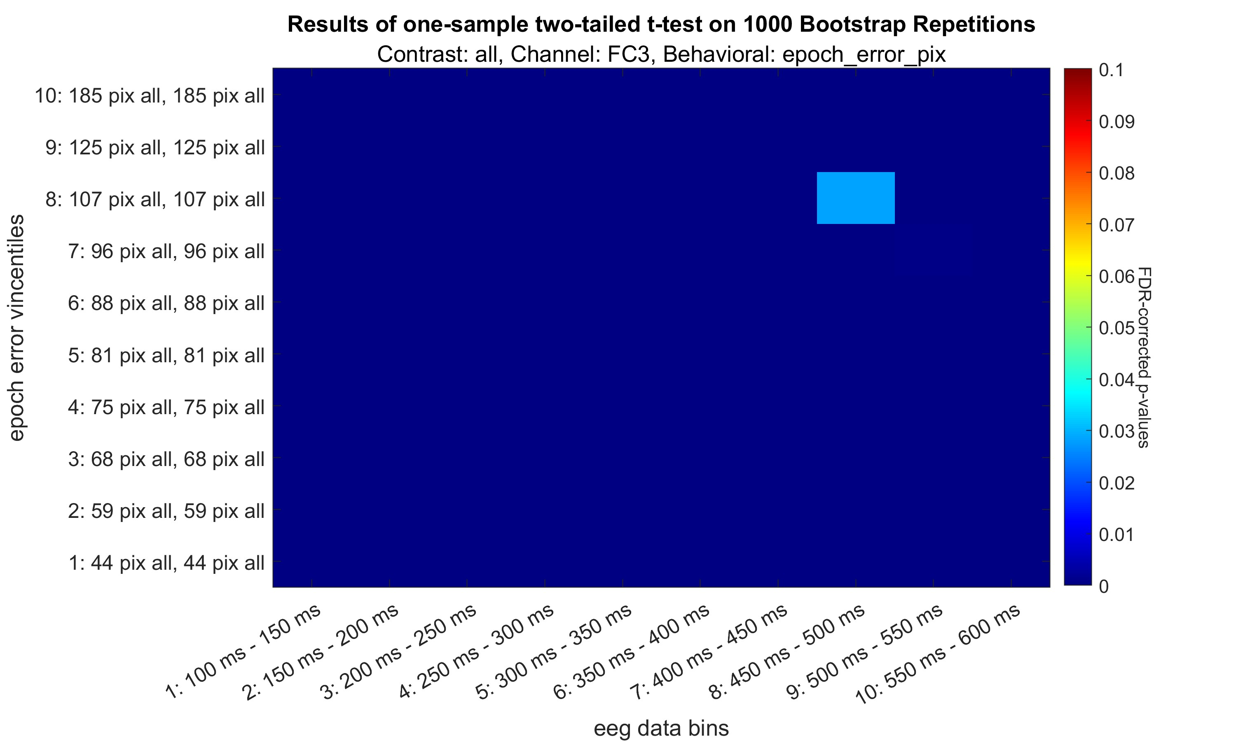

Slide 27
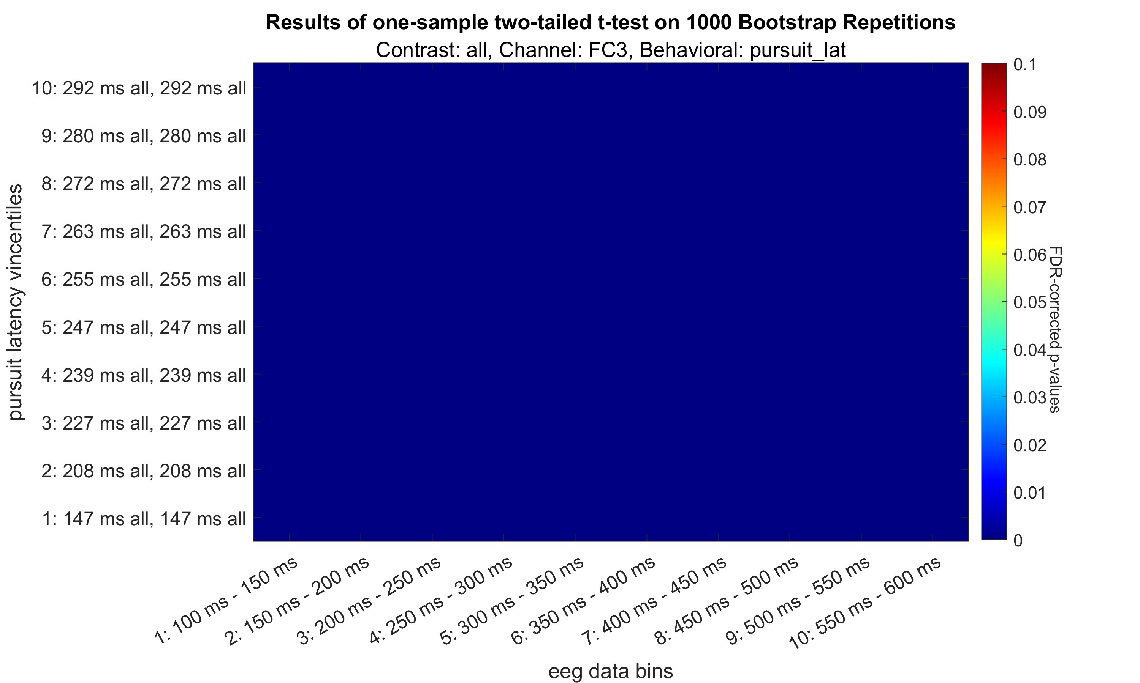

Slide 28
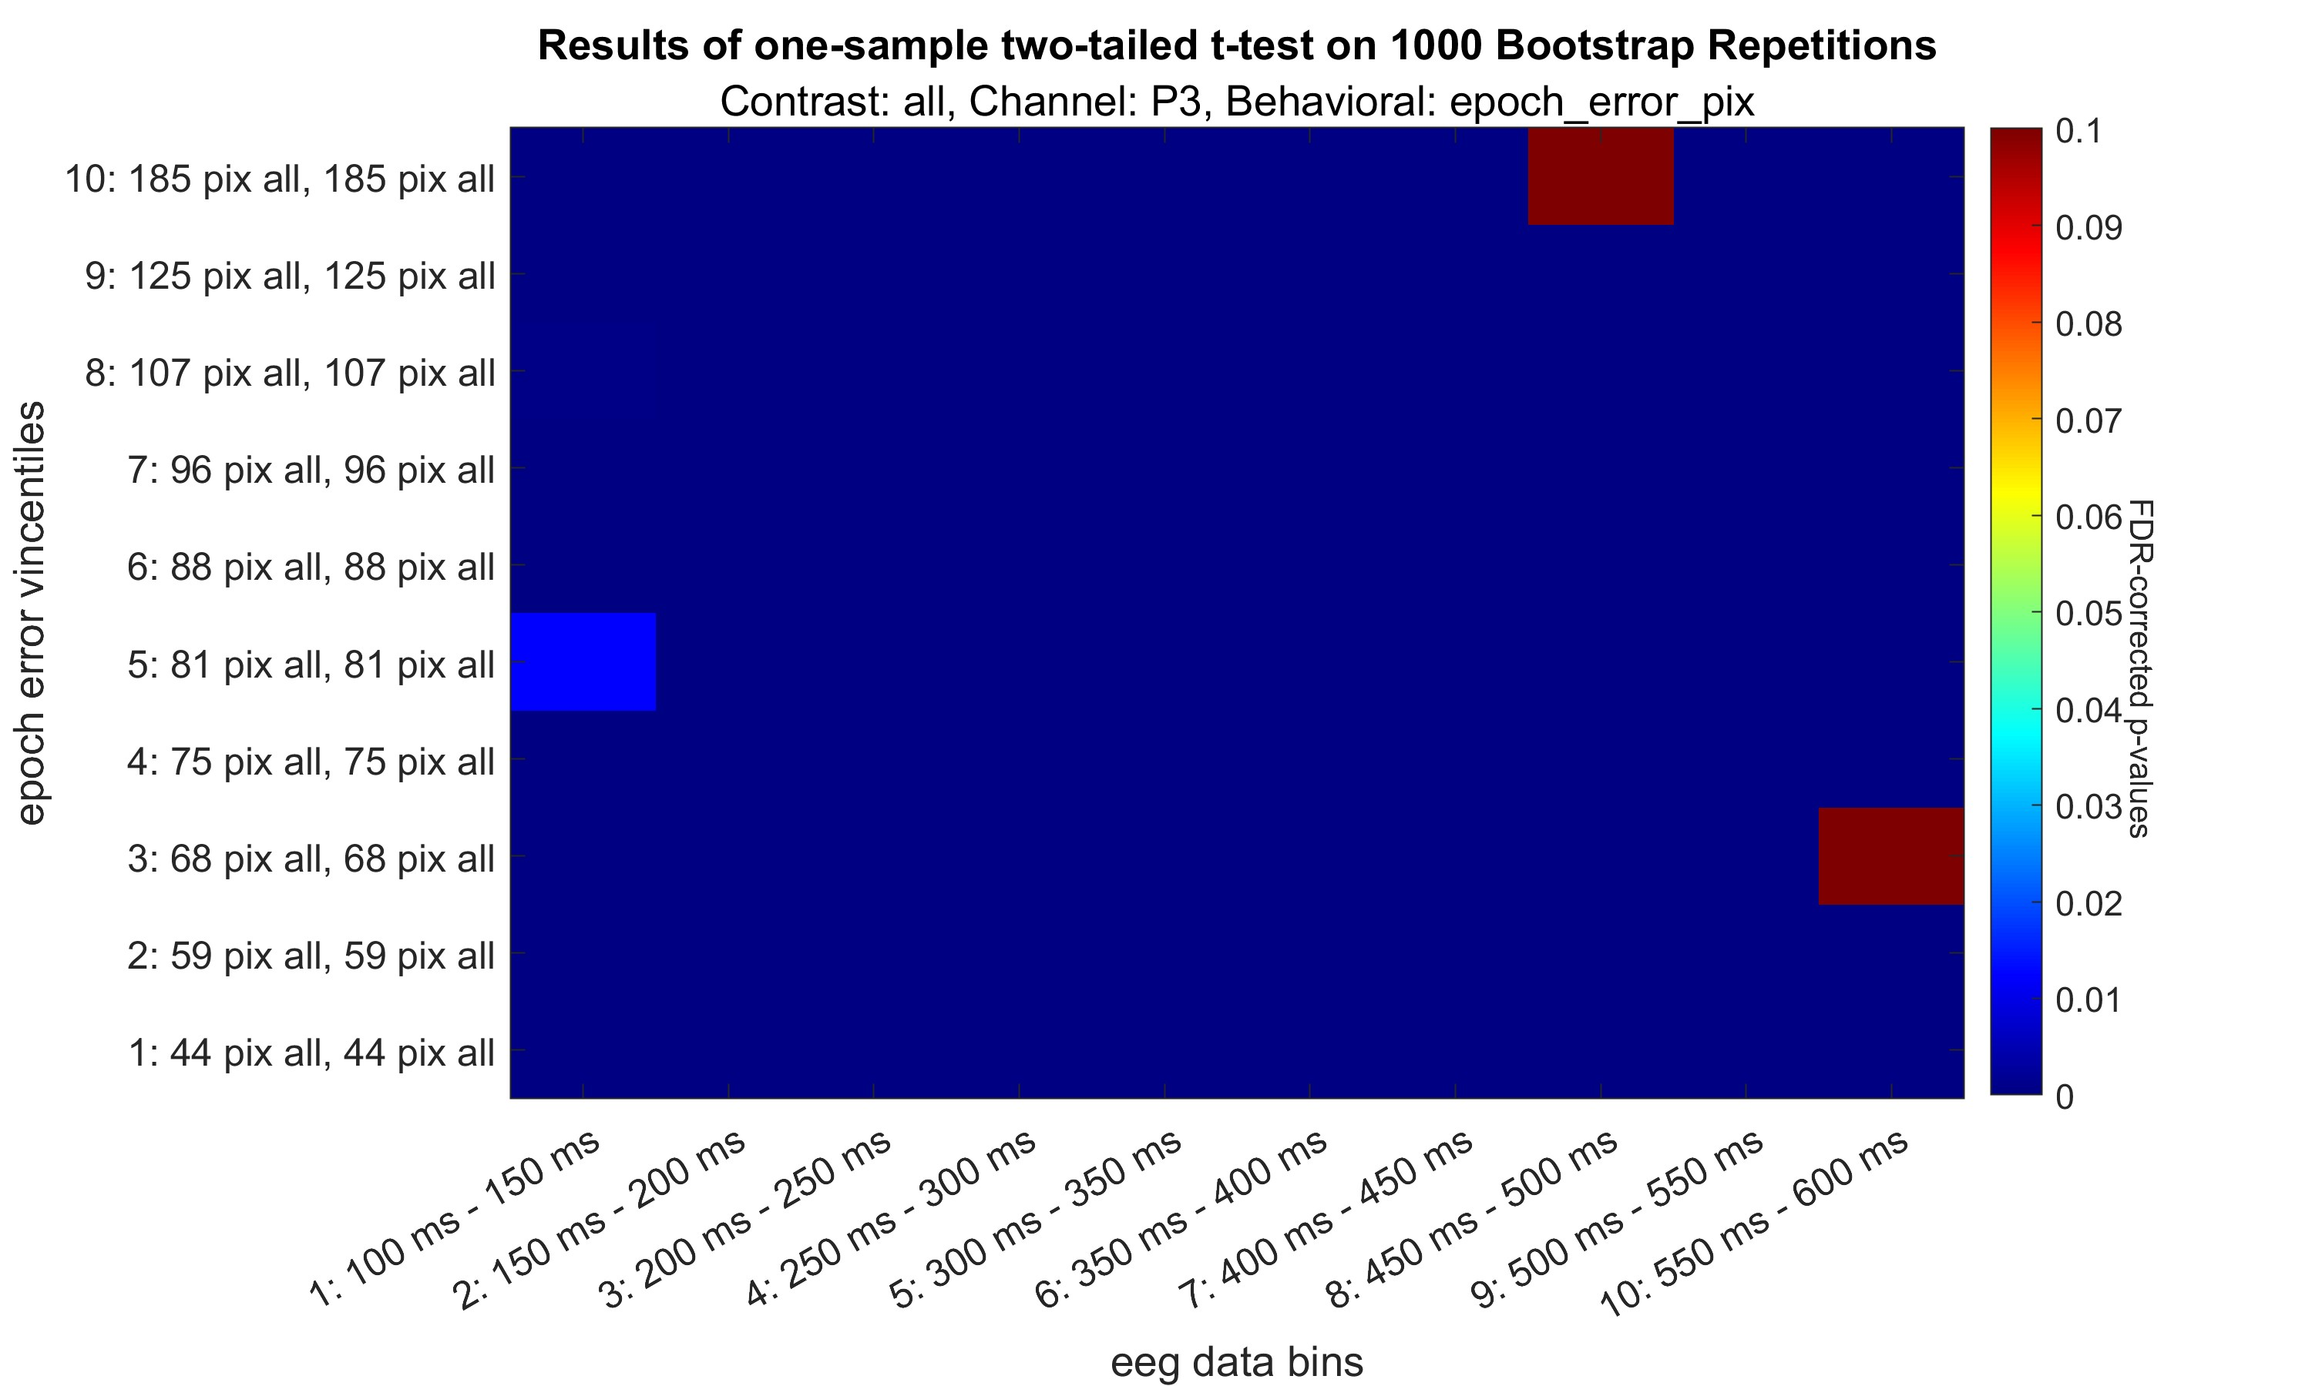

Slide 29
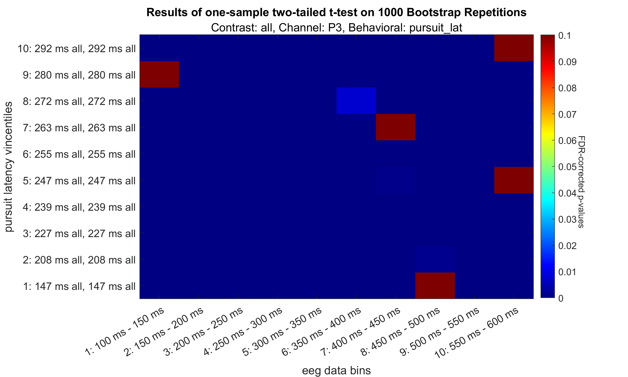

Slide 30
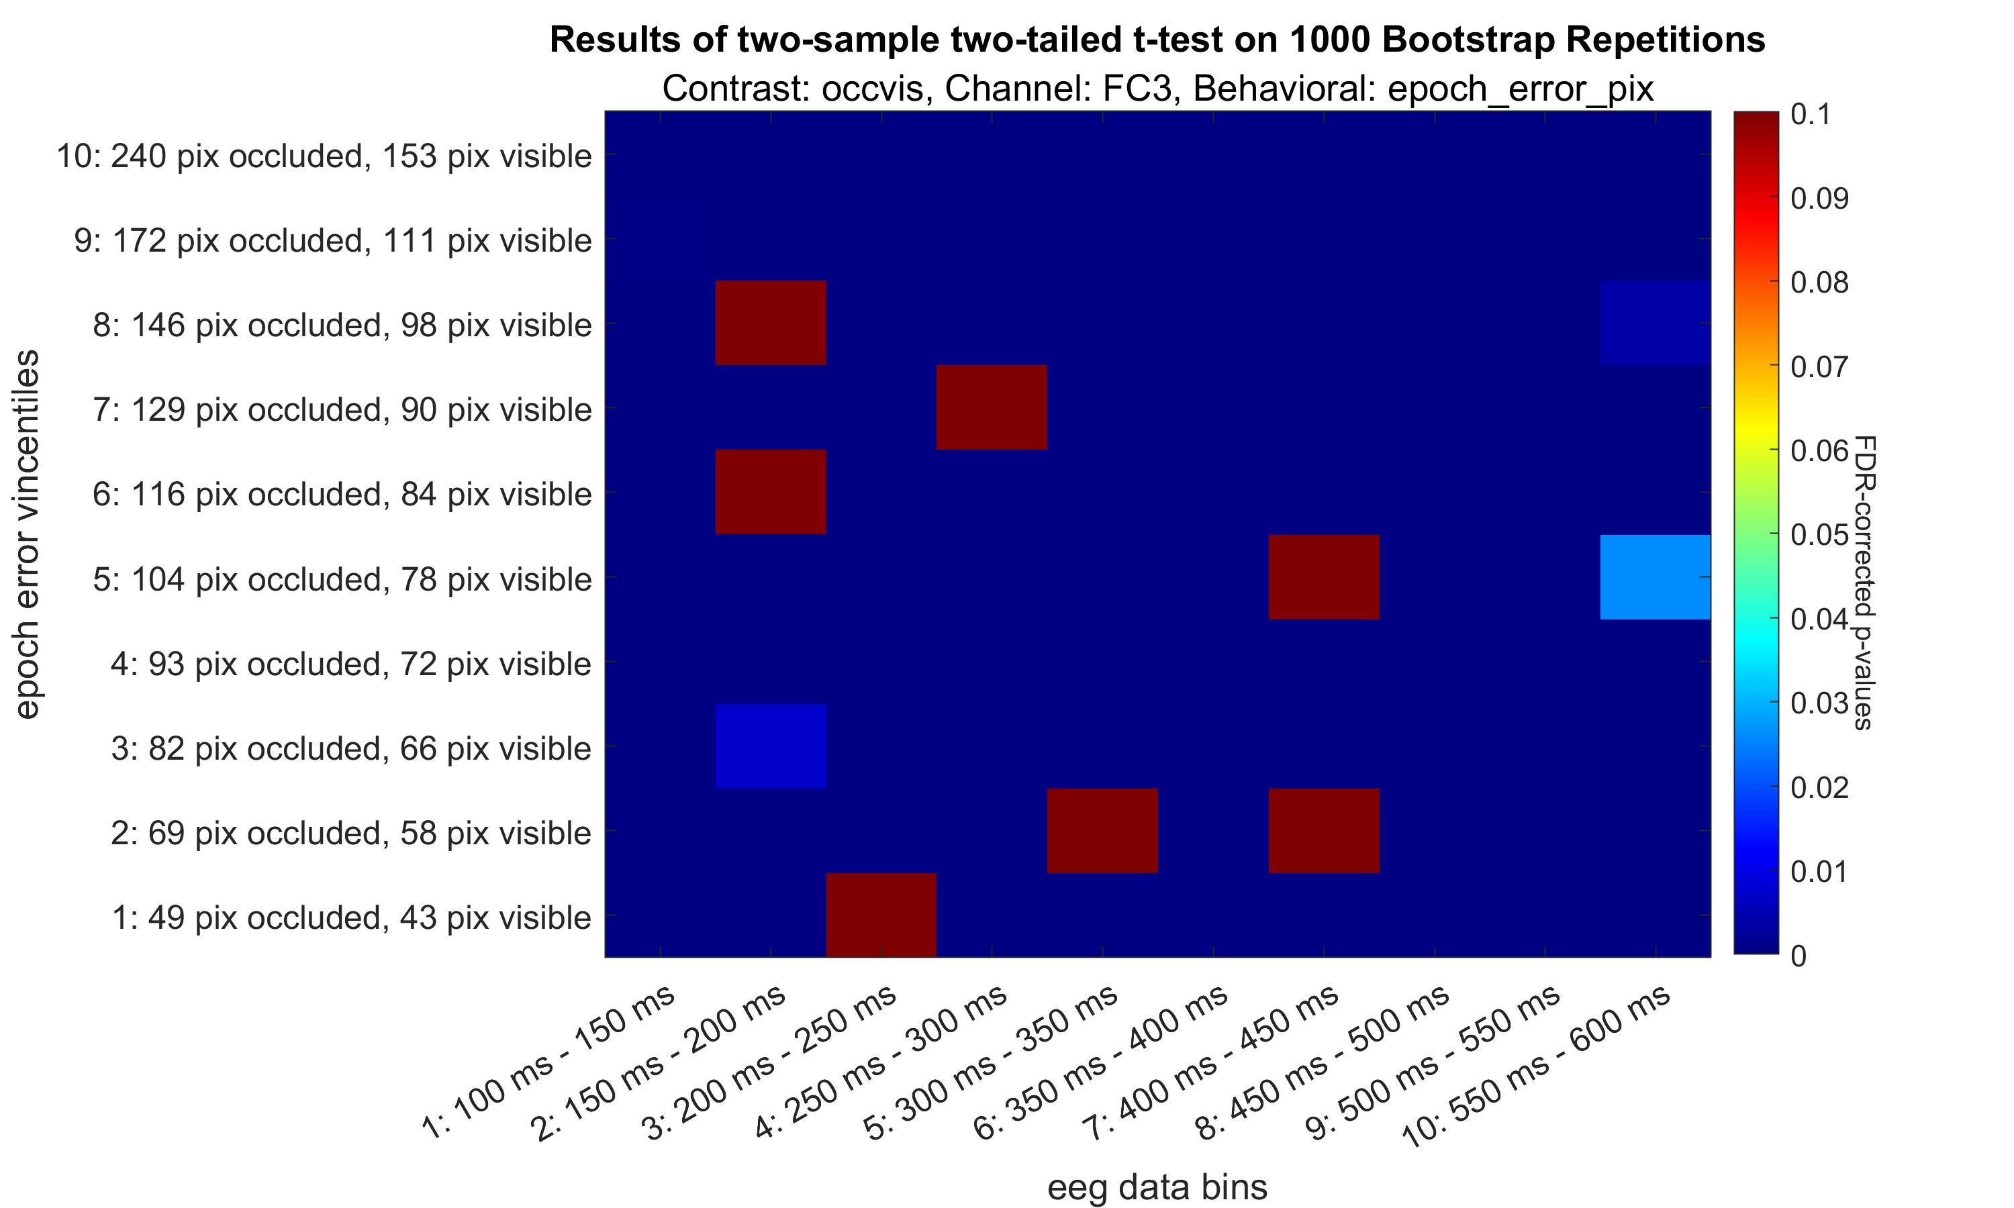

Slide 31
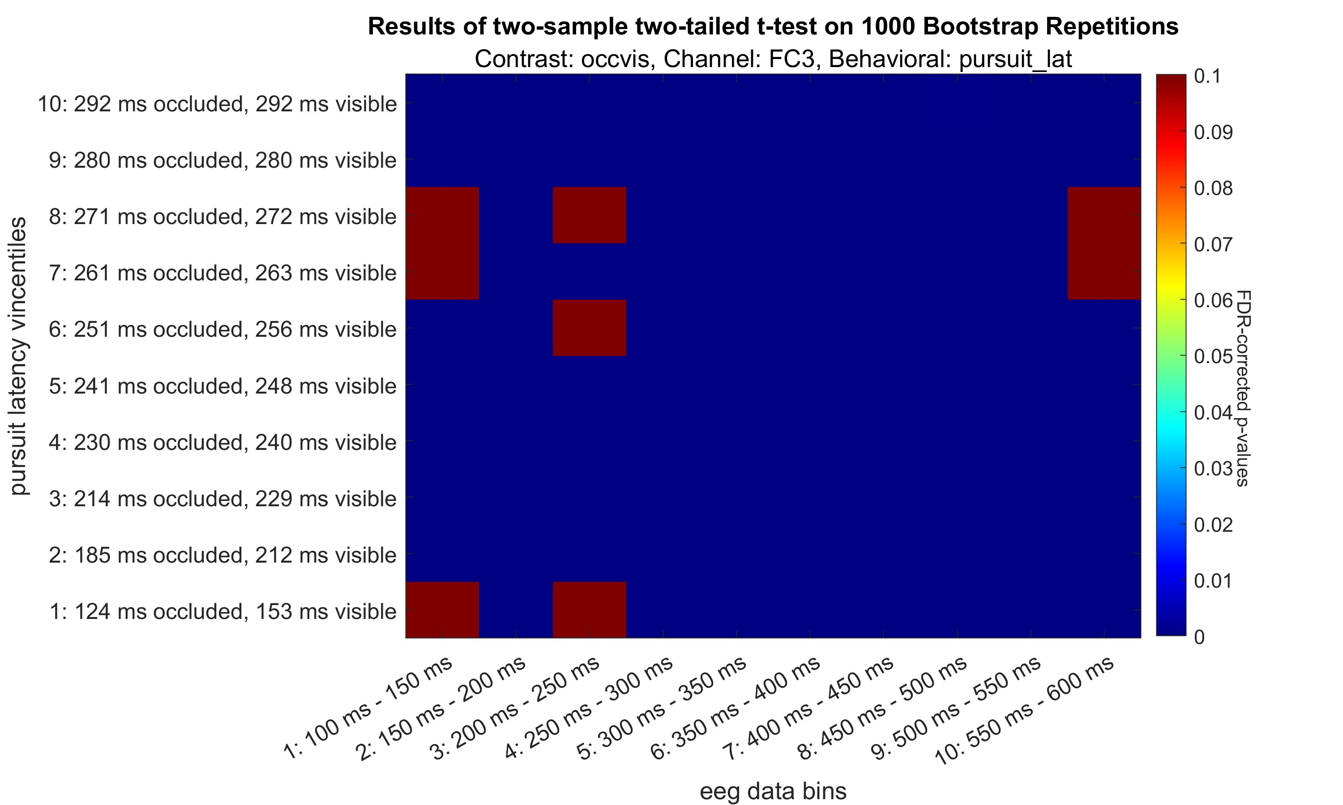

Slide 32
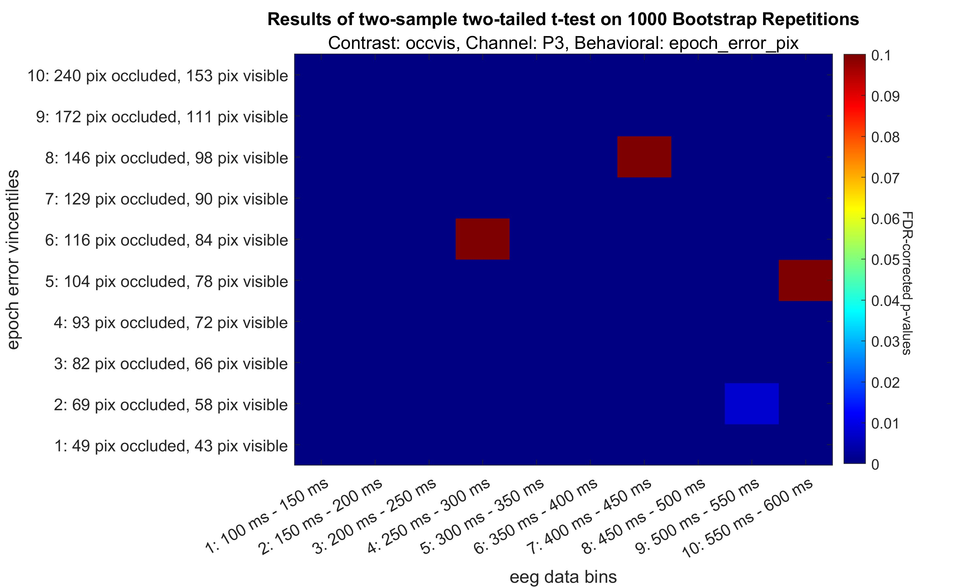

Slide 33
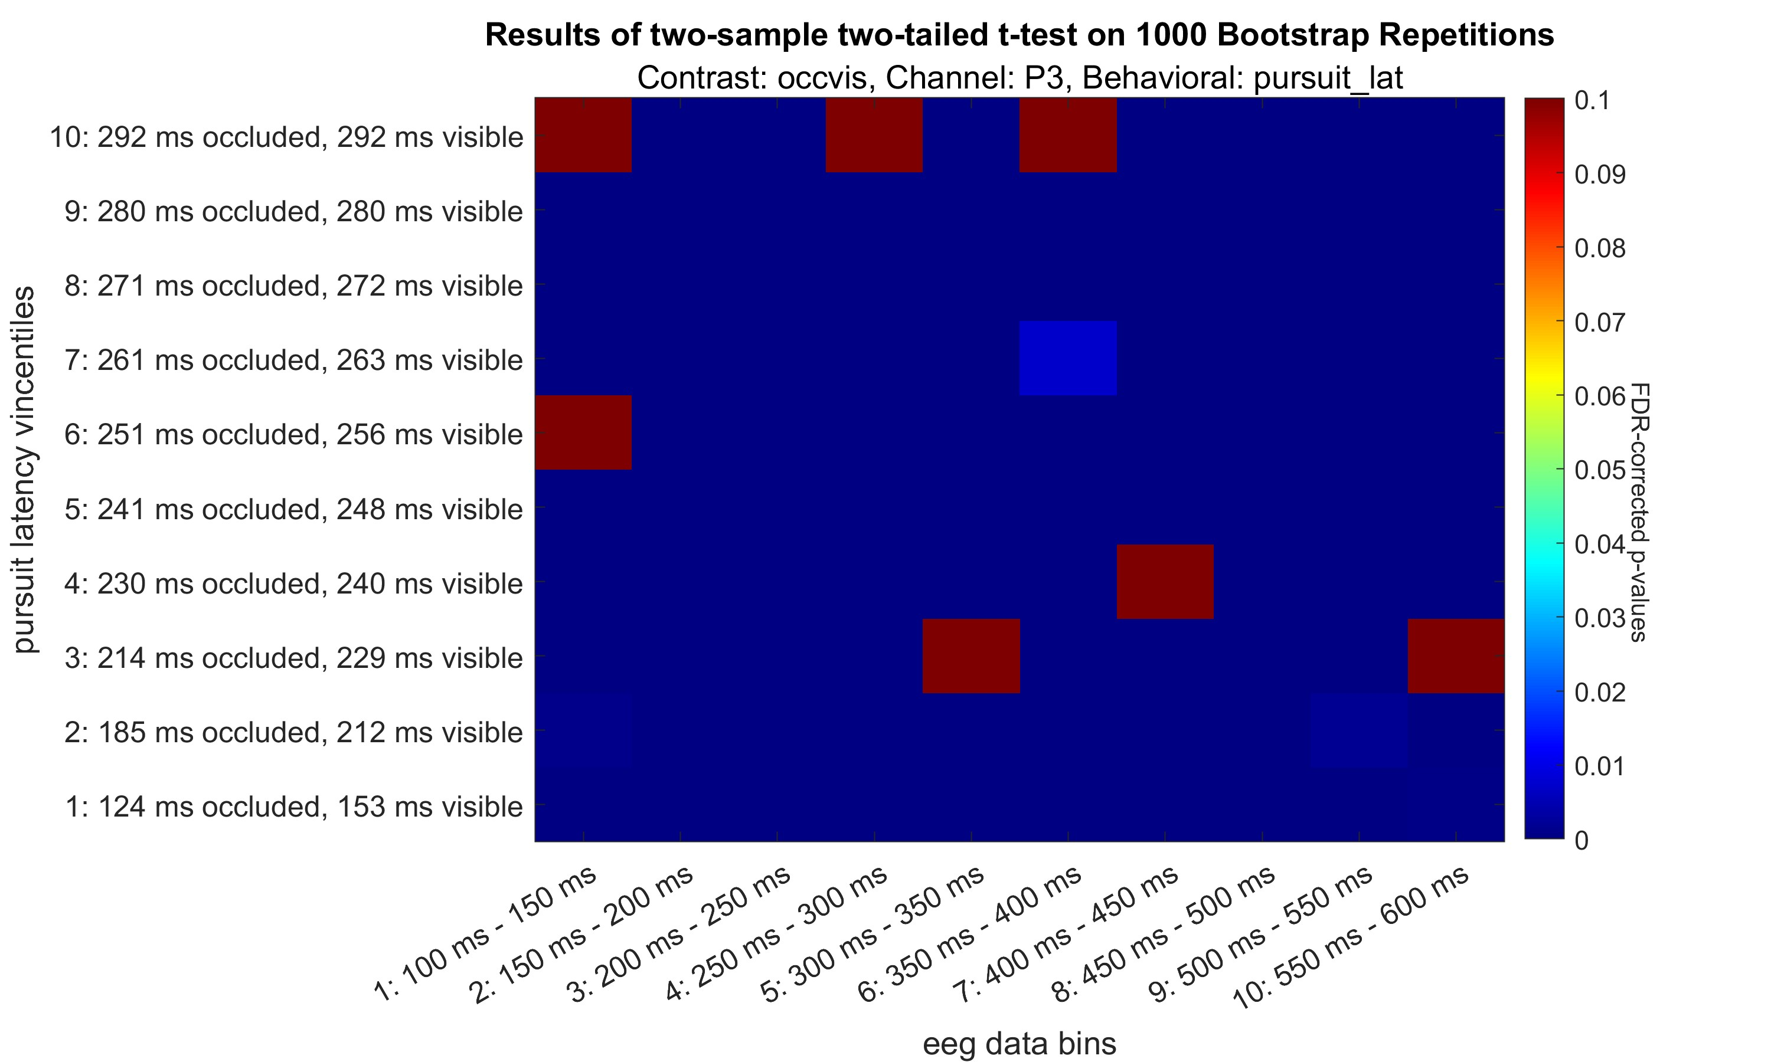

Slide 34
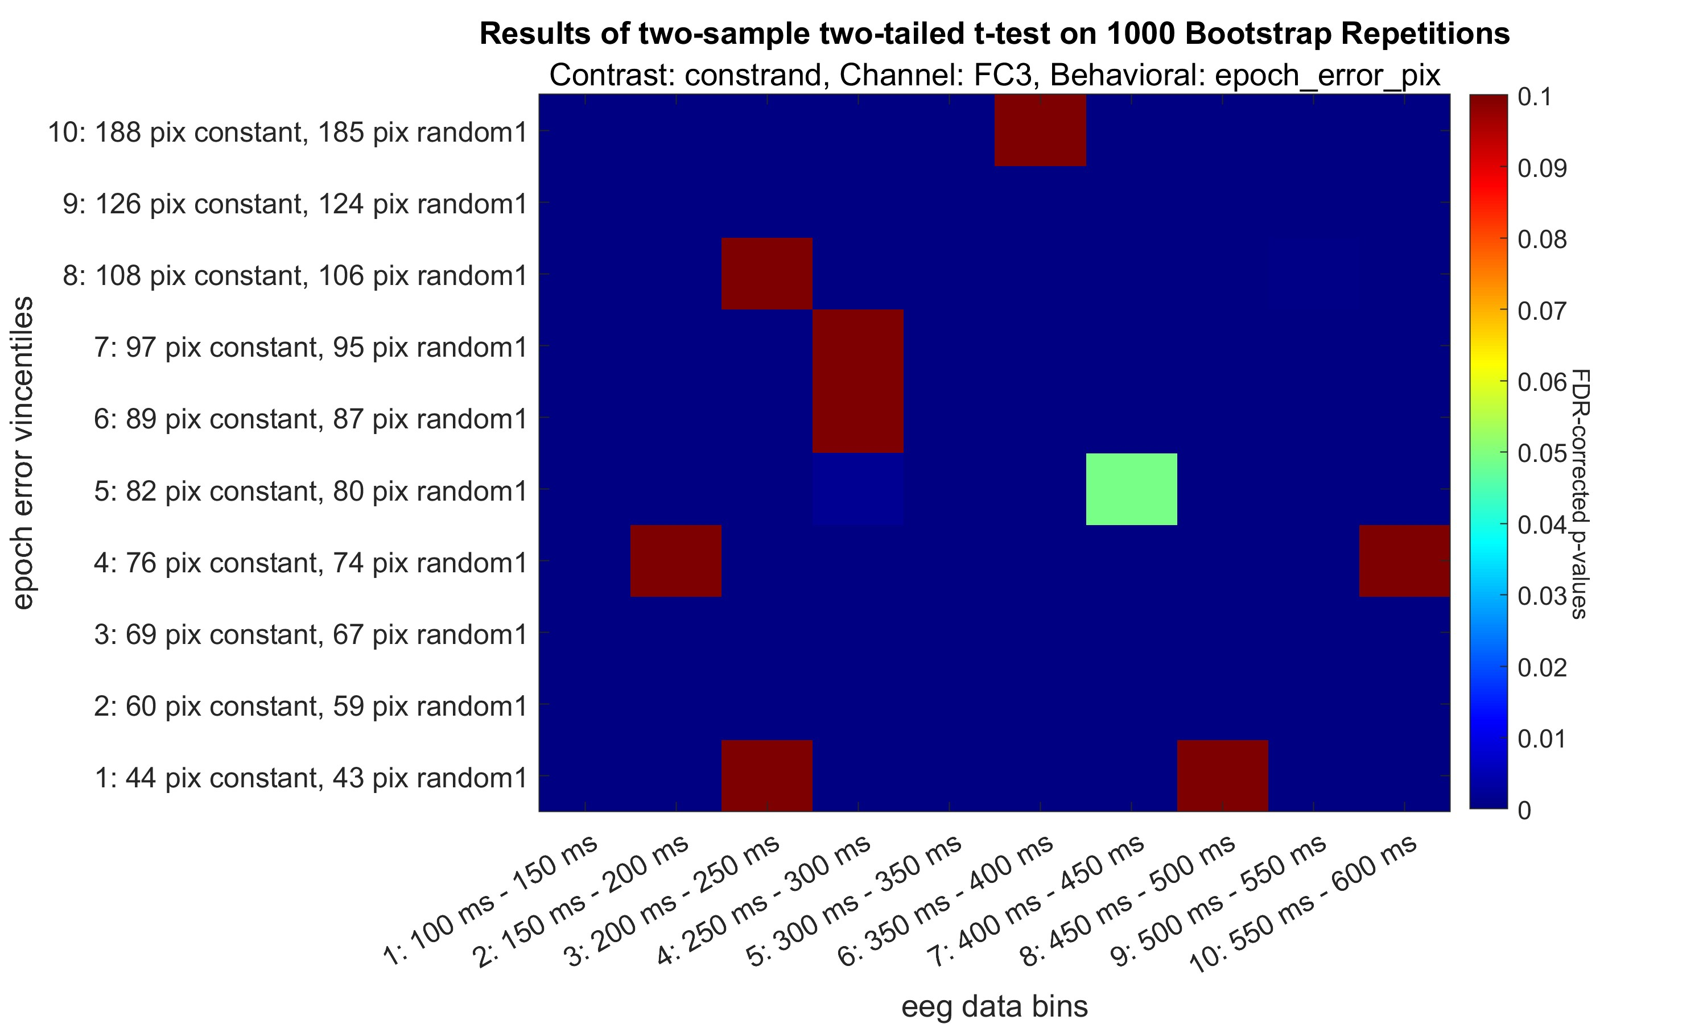

Slide 35
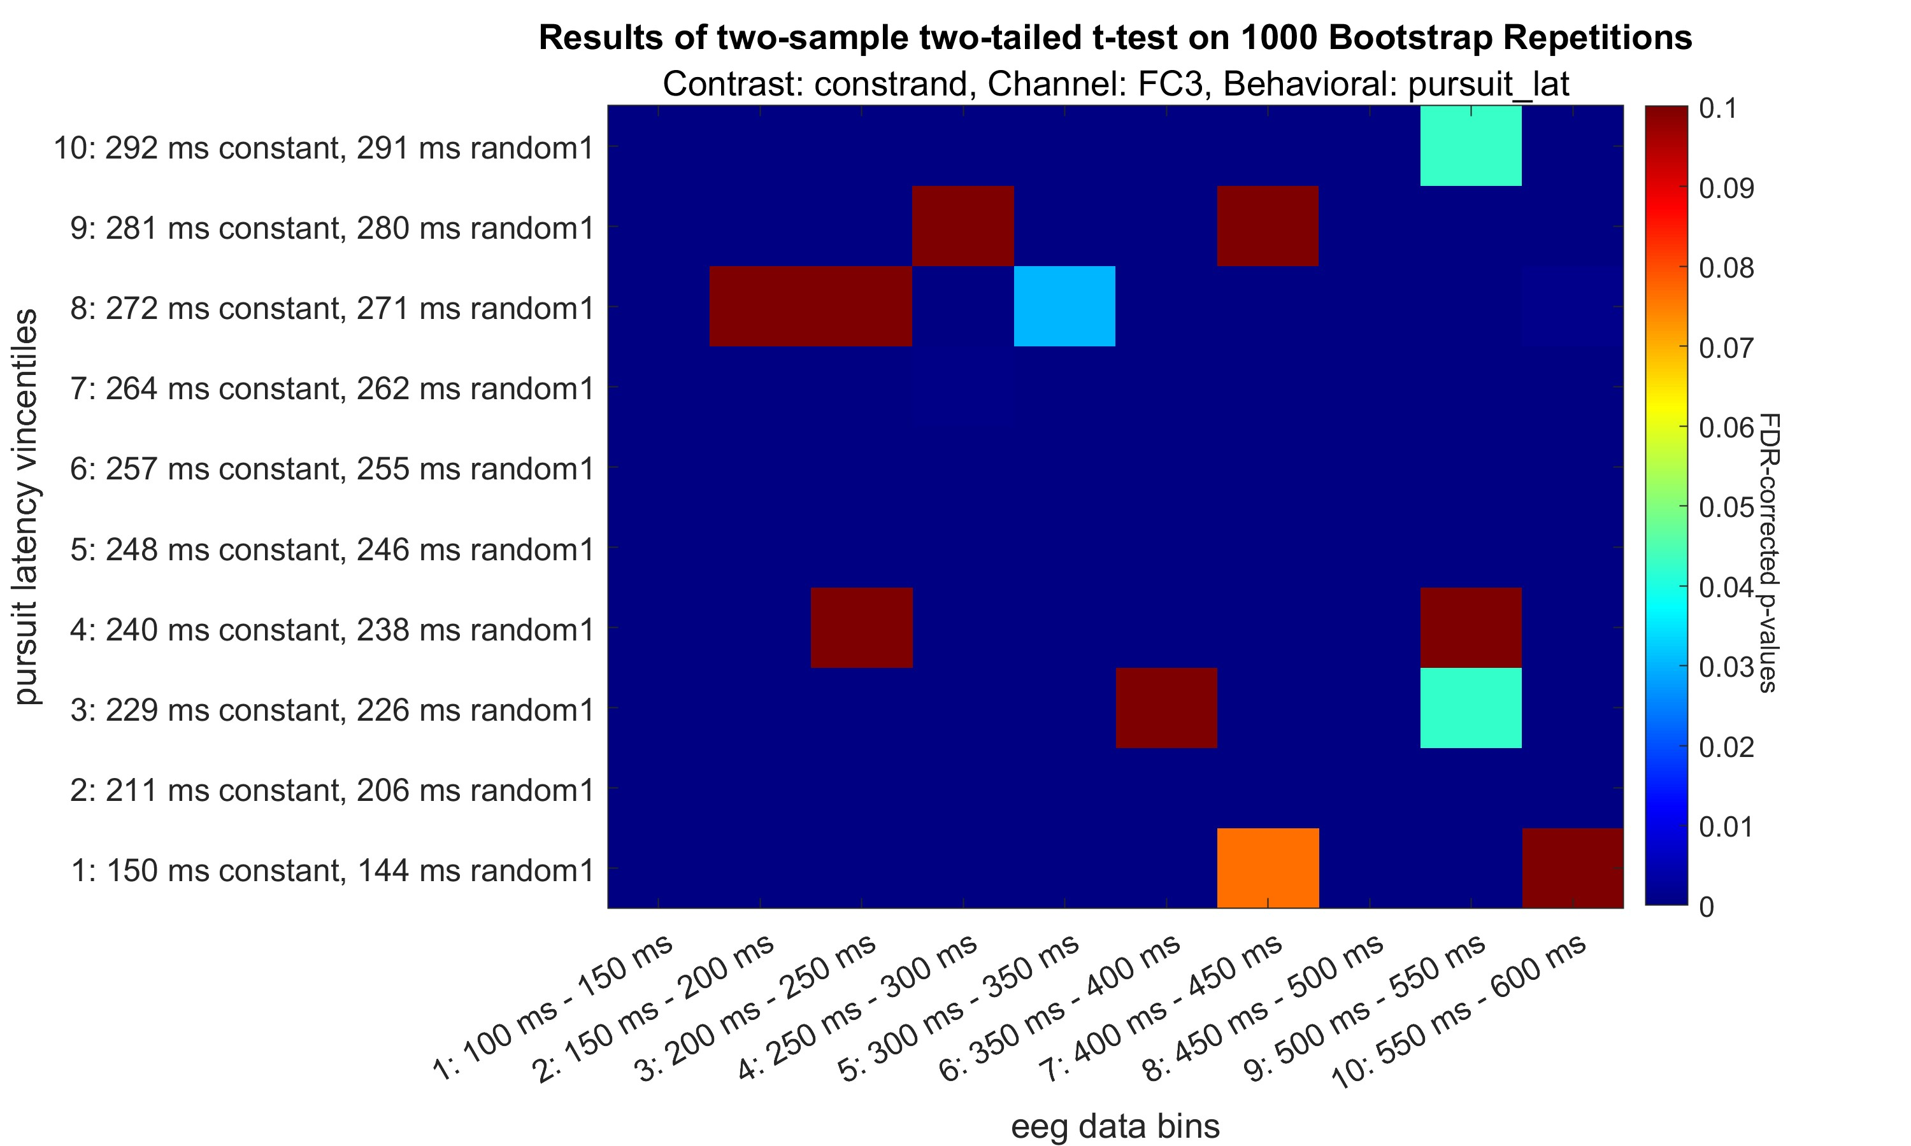

Slide 36
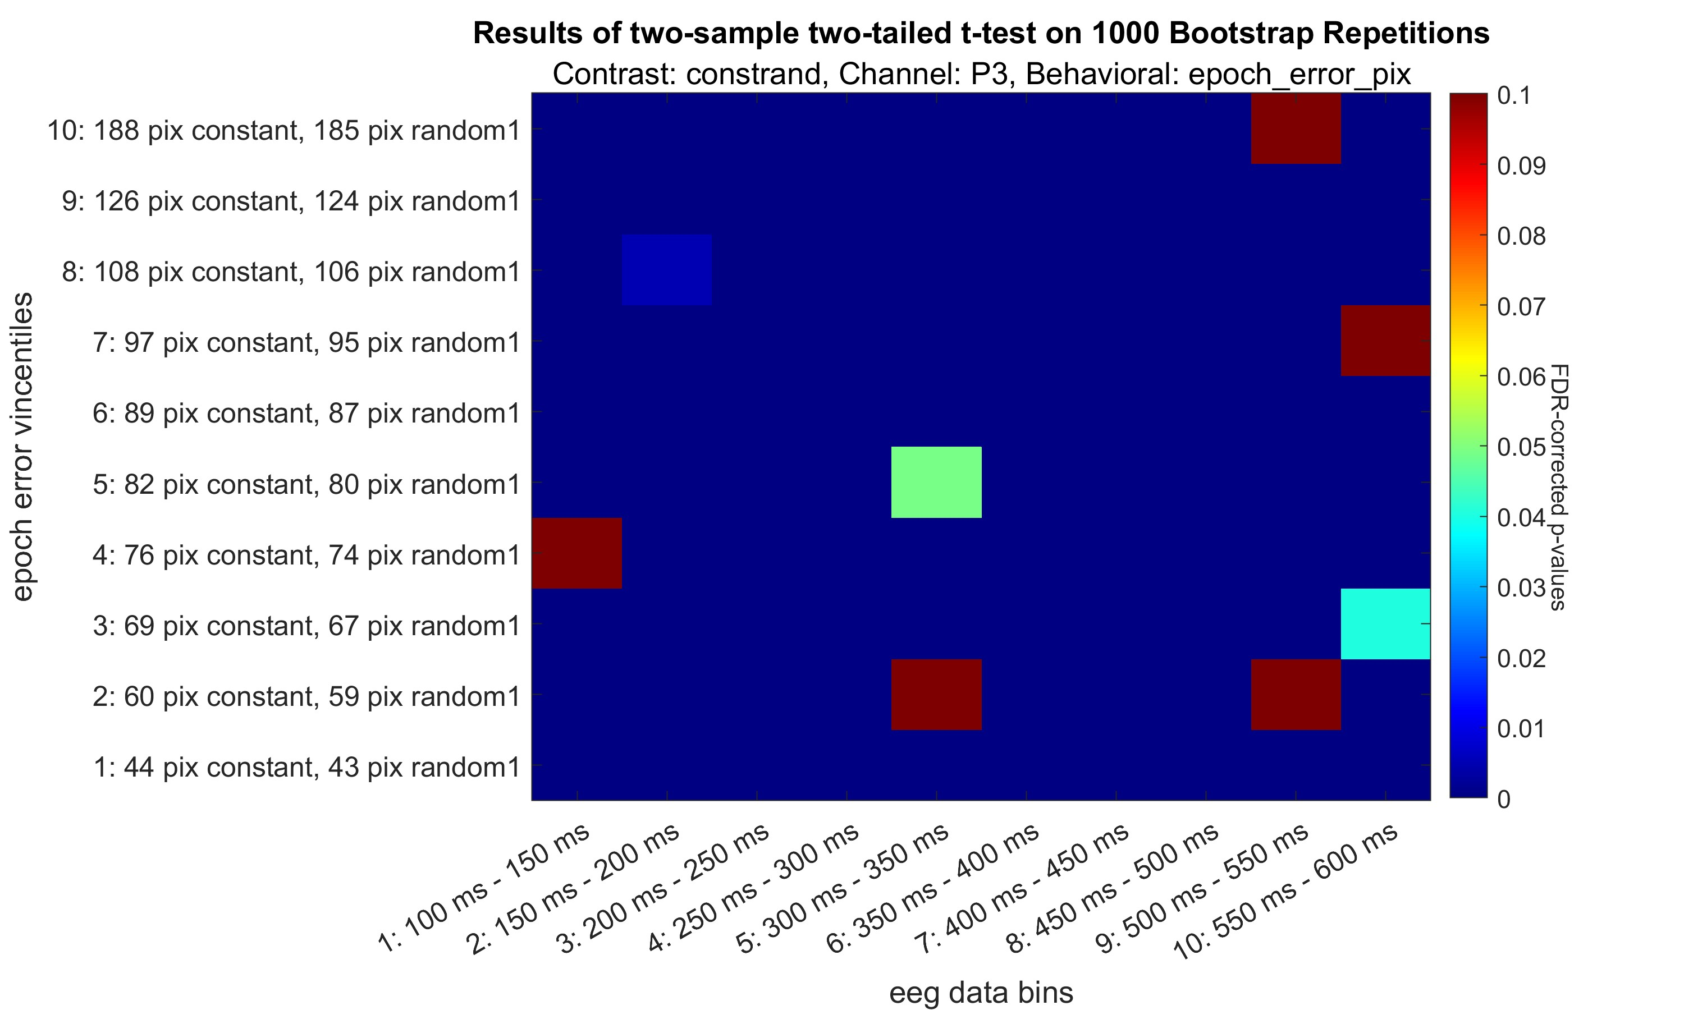

Slide 37
